Slide 1
Advocacy Update
Nebraska Credit Union League
Phil Drager
1/22/26
Notes:
Title slide

Slide 2
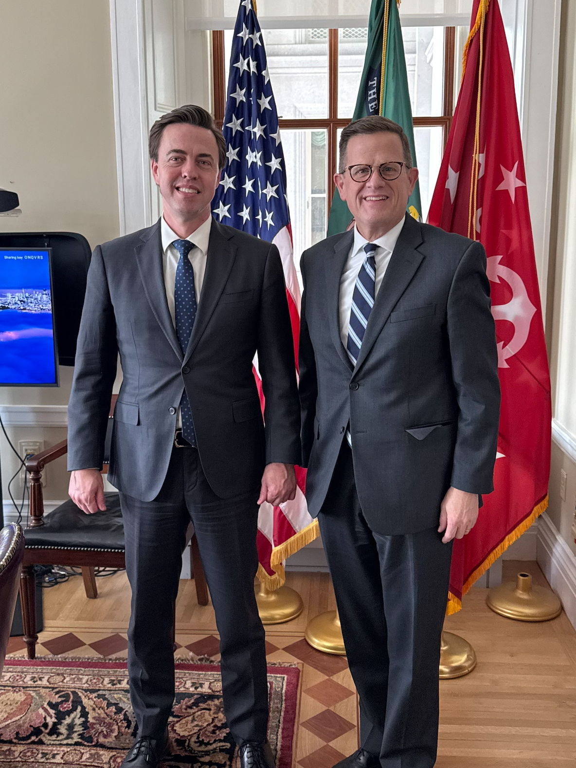

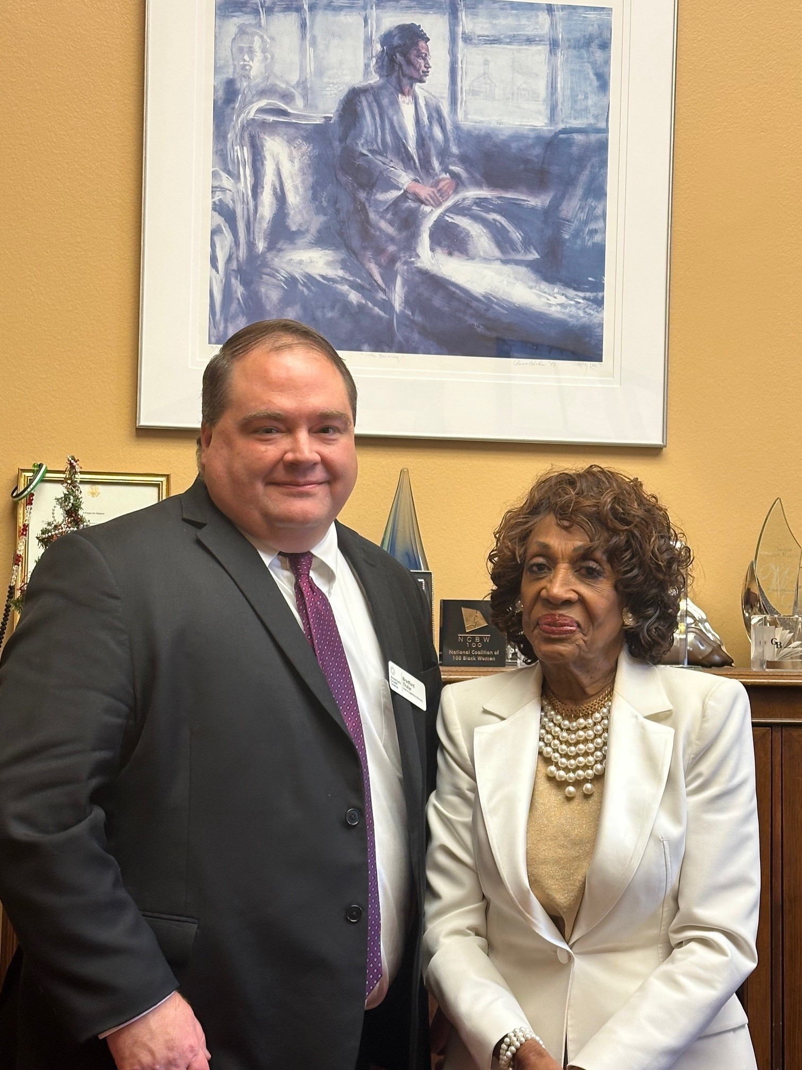
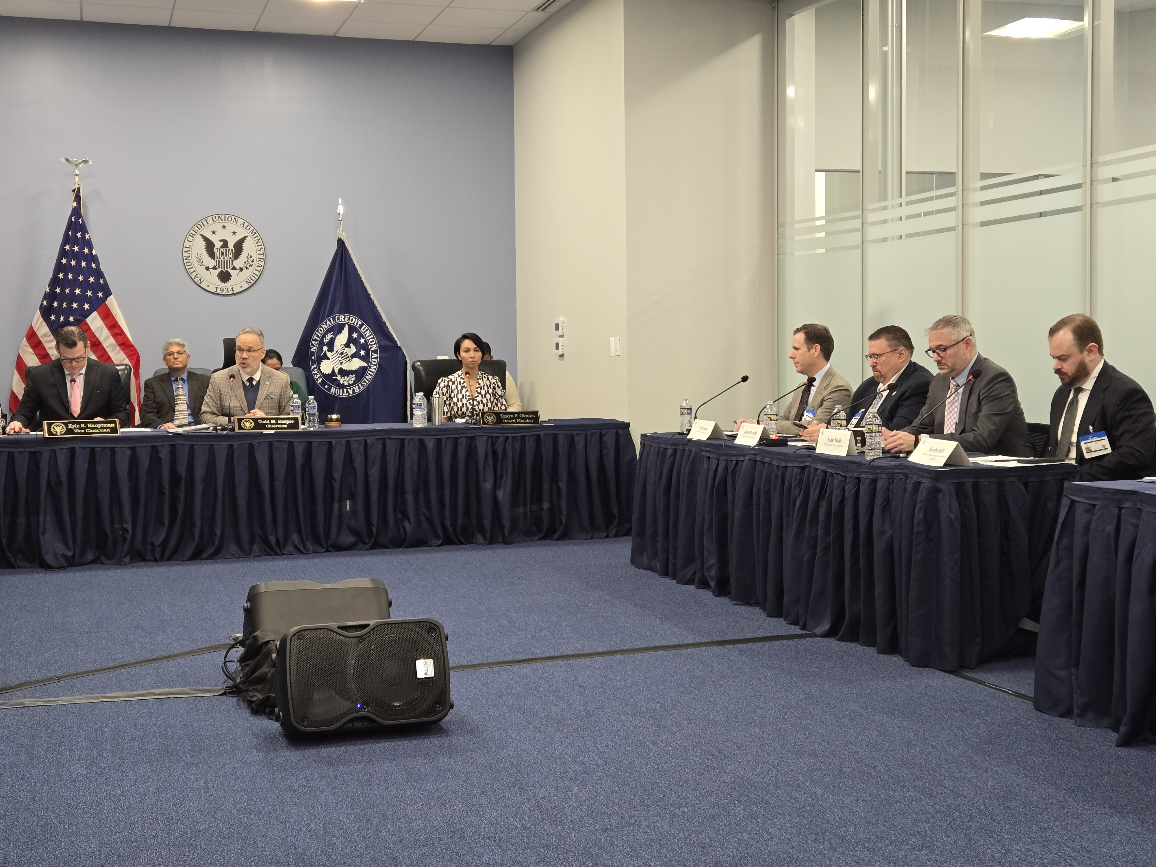
Advocacy is job one
“Together, we’ll continue to lead with purpose, protect what makes us unique, and show the country that people helping people isn’t just our history, it’s our future.”
- Scott Simpson, President & CEO

Slide 3
2026 Policy Priorities
Advance
Be relentless in our efforts to ensure credit unions can provide the services that consumers want and deserve.
Protect
Defend credit unions from attacks—whether it’s preserving the credit union tax status, addressing data security needs, challenging big bank encroachment, fighting for regulatory oversight of developing industries, or tackling overzealous regulatory burdens.
Empower
Fiercely advocate for legislative and regulatory changes that enhance credit union powers to serve their over 140 million members.

Slide 4
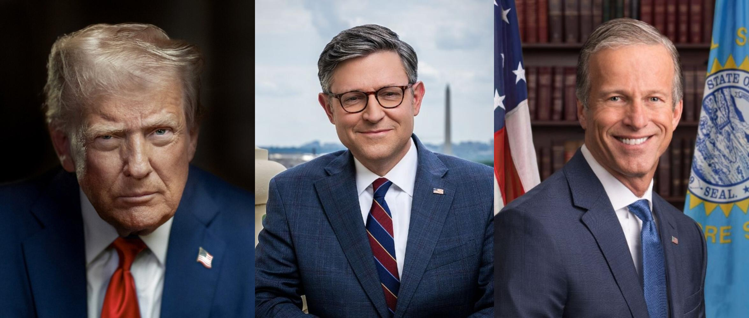
Political Landscape
Republican Congressional leaders, working with President Trump, have successfully kept their members (mostly) in line despite internal tensions and maintain slim majorities.
As Congress hurdles towards the midterms, vulnerable moderates will take center stage as they defend their seats.
A slew of retirement announcements has thrown open primaries across the country.

Slide 5

2025 in the Rearview
In 2025, Republicans held a razor-thin majority together and cleared major hurdles including:
Negotiating major tax reform
Enacting bipartisan stablecoin legislation
Confirming nominations at a record pace
Democrats, after a rocky start, presented a unified opposition, shutting down the government and forcing votes on issues from healthcare to the Epstein files.
Democrats feel healthcare is an issue they can run on going into the midterms, and are similarly looking for any avenue to put pressure on the majority.

Slide 6

Legislative Updates – Reconciliation
Passage of the One Big Beautiful Bill fulfilled much of the President’s agenda.
America’s Credit Unions, the Leagues, and individual credit unions activated to combat an unprecedented threat to the credit union tax status.
The bill has a number of smaller provisions impacting credit unions.
Notes:
The 870-page, multitrillion dollar tax and spending bill, contains multiple provisions impacting credit unions.
Remittances taxed at 1%
EV tax credits terminated, but interest on loans for US-built cars is tax deductible
Trump Accounts created
Major student loan overhaul
Excise tax on organizations for “highly paid” executives

Slide 7

Legislative Updates – What Now?
Entering 2026, Congress only has a brief window to legislate before election season kicks into full swing.
With Reconciliation in the rearview, the focus will shift.
Affordability issues rising to the forefront.
Most government funding for 2026 needs to be tackled in January.
ACA/healthcare expected to get a lot of focus. Tax aspects could need pay-fors.
Congressional outlook for 2026:
House Financial Services expected to tackle housing/community banking package.
Senate working on crypto market structure bill.
AI continues to gather attention.
Notes:
Focused on digital assets, National Defense Authorization Act (NDAA) and appropriations for the remainder of the year.
We expect Senator Marshall to take another try at interchange again, but he has burned out his colleagues and his window has closed.
There are rumors about a second reconciliation bill, but the probability is small. Getting the various Republican factions to support such a measure would be challenging.
The most likely scenario is Congress passes stablecoin regulation, NDAA and a long-term continuing resolution (CR) and goes home for the holidays.

Slide 8
Legislative Pushes
Going into the 2nd session of the 119th Congress, legislative efforts are moving forward on all fronts.
Offensive regulatory relief pushes ramping up
Seeking advancement of CU specific relief efforts such as:
Board modernization
Extending CU loan maturities
Expanding investment options for CUs
Making is easier for CUs to join a FHLB
Other industry wide relief efforts
SARS/CTR thresholds
CFPB reforms
Fighting fraud
Defensive moves continue as well:
Protecting credit unions from bank attacks, whether that be on tax status or reporting requirements
Fighting merchant efforts on interchange

Slide 9
Credit Union Legislative Priorities
Tax Exemption
Fighting Banker efforts to go after tax exemption or create new reporting requirements
Regulatory Reform
Raising SAR/CTR thresholds
Roll back regulatory burdens
Federal Credit Union Act Modernization
Loan maturities and Member Business Loan Cap
CFPB Reform
Appropriations and bipartisan commission
Modifying the frequency of required board meetings
UDAAP reform
Make it easier to join a FHLB
Expanding investment authorities

Slide 10

Republicans hold the advantage in the U.S. Senate
■ Solid D ■ Likely D ■ Lean D ■ Toss Up ■ Lean R ■ Likely R ■ Solid R ■ No election
SENATE
Republicans currently hold a 53-47 majority in the Senate; 22 of the 35 Senate seats up for election are Republican-held, giving Democrats an opportunity to flip the chamber
WA
MT
ND
VT
ME
OR
MN
NH
ID
SD
WI
NY
WY
MI
NE
IA
PA
MA
NV
UT
IL
IN
OH
CA
CO
WV
RI
KS
MO
KY
VA
CT
Democrats need a net pick up of 4 or more seats to win control of the Senate
4
TN
NC
NJ
AZ
NM
OK
AR
SC
DE
MS
AL
GA
MD
AK
TX
LA
HI
FL
*The seats of Sens. King (ME) and Sanders (VT) are considered “Democrat”
SOURCE The Cook Political Report with Amy Walter
Notes:
Sources:
“2026 CPR Senate Race Ratings,” Cook Political Report with Amy Walter, August 13, 2025, https://www.cookpolitical.com/ratings/senate-race-ratings

Slide 11

Democrats have an easier path to winning the House
Likely Democrat
17 DEM
Lean Democrat
10 DEM, 1 GOP
Toss Up
5 DEM, 12 GOP
Lean Republican
3 DEM, 5 GOP
Likely Republican
2 DEM, 11 GOP
HOUSE OF REPRESENTATIVES
Republicans hold a slim 219-213 majority in the House; The Cook Political Report rates 18 seats as toss-up, giving Democrats an opportunity to flip the chamber
CA-21 Costa
CA-25 Ruiz
CA-47 Min
CT-05 Hayes
IL-17 Sorensen
IN-01 Mrvan
MI-03 Scholten
MN-02 OPEN (Craig)
NH-01 OPEN (Pappas)
NH-02 Goodlander
NV-01 Titus
NV-04 Horsford
NY-18 Ryan
NY-22 Mannion
OR-05 Bynum
PA-17 Deluzio
WA-08 Schrier
CA-45 Tran
FL-23 Moskowitz
MI-08 McDonald Rivet
NE-02 OPEN (Bacon)
NJ-09 Pou
NV-03 Lee
NY-03 Suozzi
NY-19 Riley
OH-13 Sykes
TX-28 Cuellar
VA-07 Vindman
CA-13 Gray
NM-02 Vasquez
NY-04 Gillen
OH-01 Landsman
WA-03 Perez
AZ-01- OPEN (Schweikert)
AZ-06 Ciscomani
CA-22 Valadao
CA-48 Issa
CO-08 Evans
IA-01 Miller-Meeks
MI-07 Barrett
NJ-07 Kean Jr.
PA-07 Mackenzie
PA-10 Perry
VA-02 Kiggans
WI-03 Van Orden
IA-03 Nunn
MI-10 OPEN (James)
NC-01 Davis
NY-17 Lawler
OH-09 Kaptur
PA-08 Bresnahan
TX-34 Gonzalez
VA-01 Wittman
AK-AL Begich III
AZ-02 Crane
CO-03 Hurd
FL-13 Luna
IA-02 OPEN (Hinson)
ME-02 OPEN (Golden)
MI-04 Huizenga
MT-01 Zinke
NC-11 Edwards
PA-01 Fitzpatrick
TX-15 De La Cruz
TX-35 OPEN (Casar)
WI-01 Steil
Democrats need a net pick up of 3 or more seats to win control of the House
3
Democrat-held seat
Republican-held seat
Freshman member
SOURCE The Cook Political Report with Amy Walter
Notes:
Source:
“2026 House Race Ratings,” The Cook Political Report with Amy Walter, August 13, 2025, https://www.cookpolitical.com/ratings/house-race-ratings

Slide 12
2026 Midterms: likelihood of potential outcomes
POTUS | House | Senate | Likelihood | Likelihood analysis
R | D | R | High ••••• | The president’s party has lost seats in 17 of 19 midterm elections since WWII, and Democrats would need to flip just three seats to secure a majority in the House
R | R | R | Medium ••••• | The Senate map is favorable for Republicans, and redistricting efforts across several Republican-led states could help the GOP maintain control if President Trump remains popular with his base
R | D | D | Very Low ••••• | Save an economic crash, or large public outcry against the Trump administration from within the GOP, it is highly unlikely that Democrats flip both chambers
R | R | D | Very Low ••••• | Highly unlikely that Democrats will perform well enough in states such as Texas, Ohio, or Iowa to flip the Senate, and not secure a House majority
SOURCE Presentation Center Analysis.
Notes:
Notes:

Slide 13


Our Planned Record Investment in 2026 Elections
$3.5M+ candidate contribution budget
Supporting incumbent champions
Vetting candidates / identifying future champions
48% Dem / 52% GOP
$4M+ in political advertising in Priority Races
PAC.AmericasCreditUnions.org
CreditUnionsVote.org

Slide 14

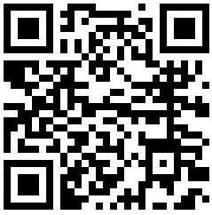
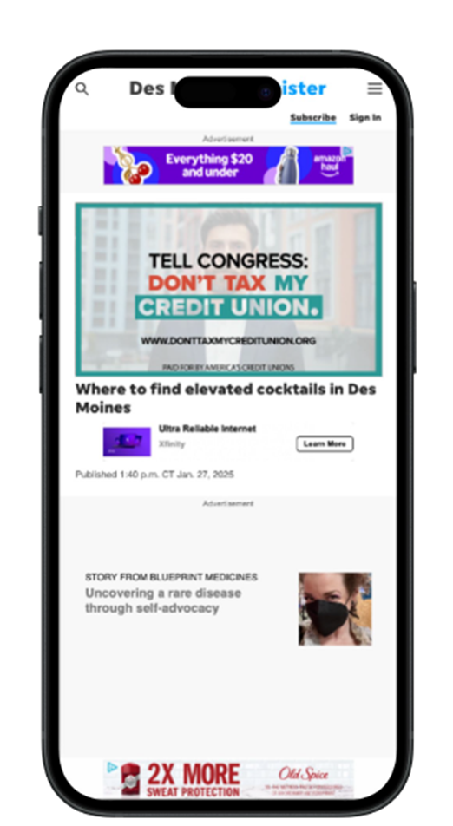

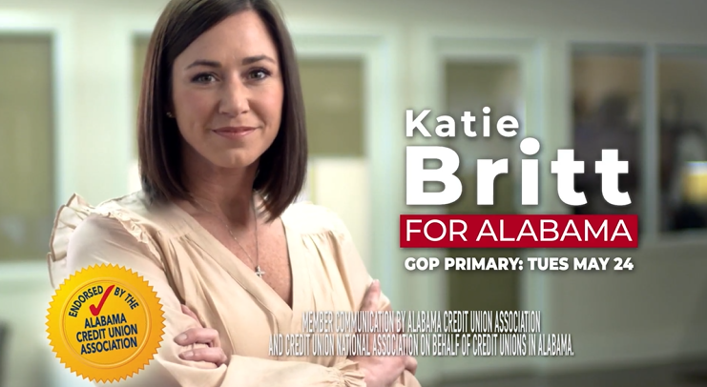
Election Year Tools for Credit Unions
Elect more CU CHAMPIONS by:
Activating your members at CreditUnionsVote.com
Donating to the National Advocacy Fund (NAF)
Engaging with America’s Credit Unions PAC
Participating in Member Communications
Learn more:

Slide 15
Regulatory Updates - Reduced Staff, Reducing Regulations
Staffing reductions across agencies.
Agency rulemakings curtailed:
10:1 guidance
Repeal of “unlawful regulations”
Regulatory review completed. Agencies have begun rolling back rules.

Slide 16

Regulatory Updates – Hauptman and the NCUA
Kyle Hauptman is continuing to serve in holdover status as Chairman of the NCUA until a successor is appointed.
His term expired on August 2, 2025.
NCUA has begun its "Deregulation Project".
Focused on regulations that are obsolete, duplicative, intended to be guidance, or overly burdensome.
GENIUS Act regulations to be released soon.
Key developments:
Single-member Board
Reduction in force
Notes:
NCUA has begun its "Deregulation Project".
Focused on changing or removing regulations that are obsolete, duplicative of statute, intended to be guidance, or overly burdensome.
NCUA Priorities under Hauptman
Re-examining the NCUA budgeting process.
Promoting the appropriate use of artificial intelligence (AI) as a tool for NCUA employees.
Focusing on true financial inclusion, which means removing barriers to de novo credit unions and removing the ‘pain points’ that have led to fewer and fewer small credit unions.
Protecting Americans from regulation-by-enforcement.
Making clear that credit unions and their members are best positioned to assess their communities’ climate risks.
Re-assessing NCUA policies that may dissuade credit unions from serving low-income areas – including language around overdraft.
Right-sizing credit unions’ obligations where possible under the Bank Secrecy Act, including around Suspicious Activity Reports.
NCUA’s 2025 Supervisory Priorities
Credit Risk
Balance Sheet Management and Risk to Earnings and Net Worth
Cybersecurity
Consumer Financial Protection
Overdraft programs
Fair lending
Home Mortgage Disclosure Act and Reg C
Military Lending Act
Electronic Fund Transfer Act and Reg E

Slide 17
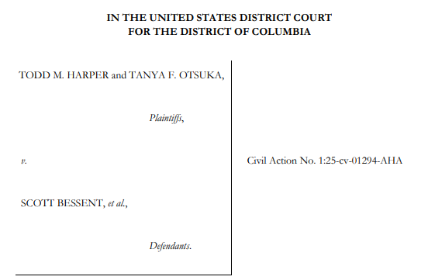
Regulatory Updates – Harper/Otsuka Lawsuit
Case Developments
April 16: Harper & Otsuka removed
April 28: Lawsuit filed
July 22: Court declares terminations unlawful, reinstated – DOJ appeals the ruling next day
July 26: Court issues stay of reinstatement
Sept 22: D.C. Circuit issues hold until SCOTUS review of Trump v Slaughter
Sept 25: Harper & Otsuka appeal for SCOTUS review alongside Slaughter
What does this mean?
Harper & Otsuka’s reinstatements halted, at least for the time being – expedited review was rejected
Outcome of Slaughter could have broad implications for other independent agencies

Slide 18

Regulatory Updates – CFPB on Life Support
Current Acting CFPB Director is Russell Vought, Director of the Office of Management and Budget (OMB).
Amid a funding crisis, CFPB has transferred all active litigation to the Department of Justice.
Supervisory capacity has drastically diminished.
Regulatory rollback and required rulemakings:
Majority of Chopra-era rulemakings removed.
Section 1071 rulemaking rewritten with fewer burdens to credit unions.
Section 1033 rulemaking to be rewritten, potentially through an interim final rule (IFR).
Notes:
Rulemaking Rollbacks
NSF Fees
Defining Larger Participants in Payment Apps
Overdraft Lending: Very Large Financial Institutions
Credit Card Late Fees
Possible Rollbacks and Changes
Medical Debt
Property Assessed Clean Energy Loans
Section 1071 Small Business Loan Data Collection
New rulemaking has been initiated

Slide 19
Regulatory Updates – Treasury
FinCEN
Corporate Transparency Act implementation on hold.
The Federal Reserve
Michelle Bowman is now the Vice Chairman for Supervision.
The Fed has been focused on capital reform for large banks.
The Reg II proposed rule is still not finalized.
Federal Trade Commission (FTC)
Andrew Ferguson has replaced Lina Khan – a massive shift in leadership.
FTC is focused on de-regulation, though keeping a strong anti-trust focus.
Treasury
While Treasury supports the CDFI Fund, OMB is withholding FY25 funds.
GENIUS Act Implementation is underway.
Treasury is working to modernize payments while reducing fraud and considering the reduced role of checks.
Treasury is working with FHFA and others to address housing affordability and the future of the GSEs.

Slide 20

Regulatory Updates – What Now?
H.R. 1 implementation and the President’s affordability agenda are top priorities for the Administration.
Regulators are moving into high gear on regulatory rollbacks.
Even with many positions unfilled, regulatory rollback and an aggressive reduction of all regulations has begun.
The precedent set by firing key regulators across the government brings long-term regulatory uncertainty.
Notes:
The Administration –
Focused on implementing H.R. 1 and the President’s trade agenda, and whatever the President posts about on social media that day.
The Regulators –
The regulatory agencies are in a freeze right now, vacancies at all major financial regulators besides the Fed have rulemaking on pause.
Once key positions are filled, look for an aggressive rewrite of Biden regulations, and regulatory rollback.
However, the changes brought by Trump in agency staffing could slow this effort down.
Also, the precedent Trump has set firing key regulators across the government brings long-term regulatory uncertainty.

Slide 21

State Updates
In 2025, interchange bills were introduced in nearly 30 states, but failed to pass anywhere.
America’s Credit Unions joined a lawsuit to stop the Illinois interchange law from going into effect.
The Illinois legislature has delayed implementation of the law until July 1, 2026.
Outside of interchange, greater state activity is expected on consumer protection going in 2026.
Notes:
Interchange: 2025 filings clustered in CO, IL, MA, NY, RI; only RI S.16 made it to enrollment.

Slide 22
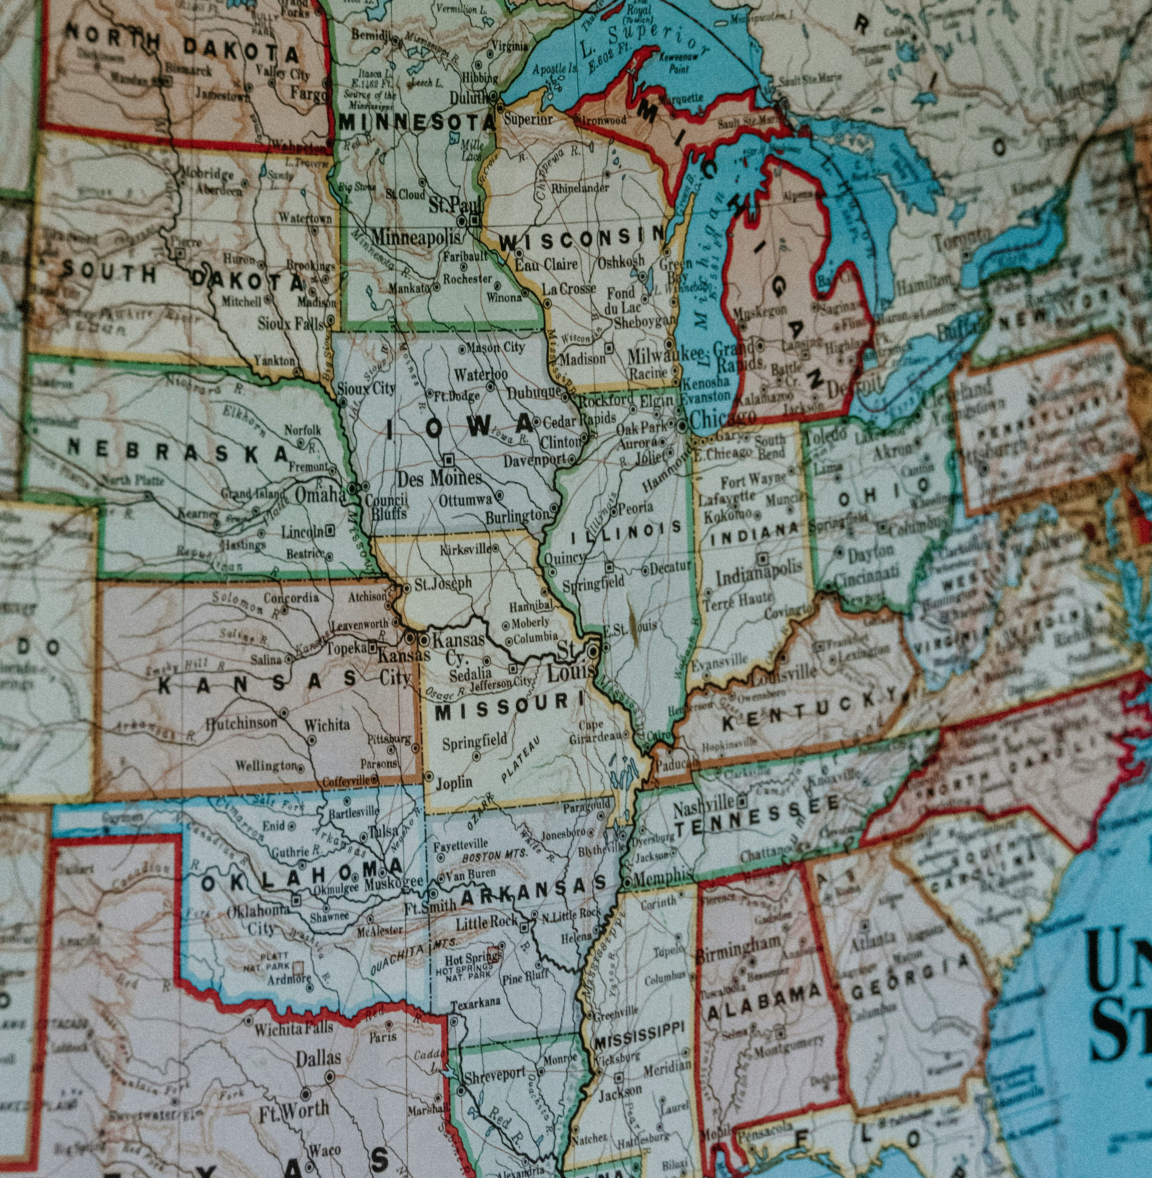
2026 State Forecast
State Privacy Acts 2.0: After CA, CO, and VA amendments in 2025, around 15 legislatures signaled new drafts of privacy bills for 2026.
Anti-ESG Bills: ESG-ban packages stalled; sponsors are now turning to procurement, proxy-voting, and risk scoring disclosures, which are easier to pass and harder to veto.
Interchange: Banking associations will sponsor “Durbin-plus” copycats in NJ, PA, and CT.
Investment Authority: At least six more states will authorize credit union-investment in school district or municipal funds, leveraging Nebraska’s 2025 template.
Digital Assets: Expect plumbing-focused bills (e.g., UCC Article 12, qualified custodians) rather than sweeping “digital-asset frameworks.

Slide 23
Questions?

