Slide 1
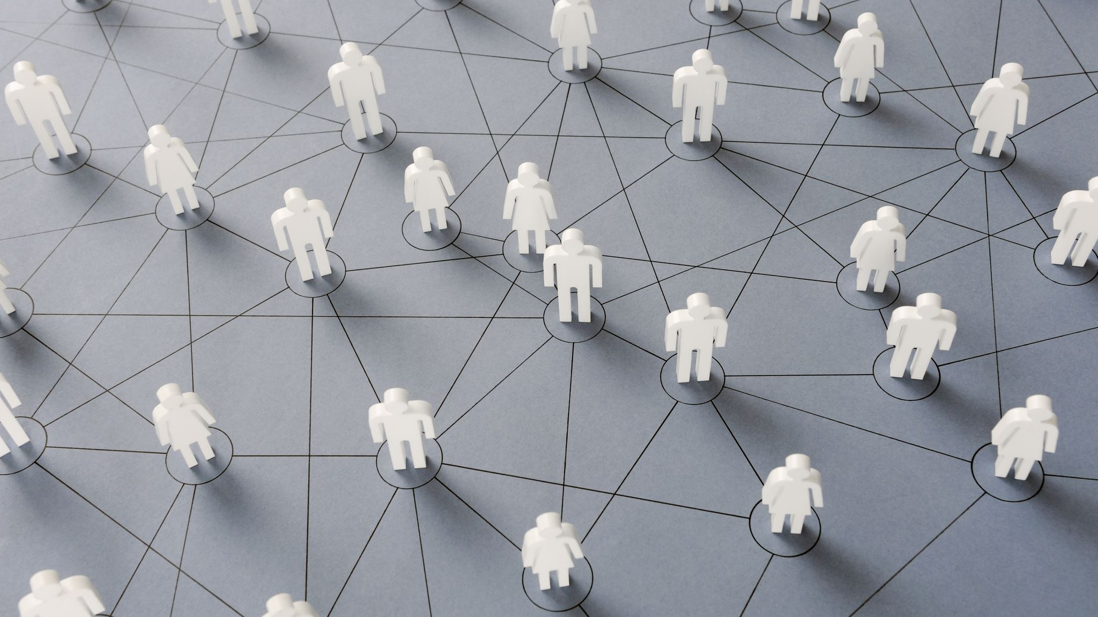
The Resilience Covenant
Protecting Member-Owner Trust in an
Environment of Chaos
Miguel Clarke
Chief Resilience Officer
Eleventh Dimension
Professional Services

Slide 2
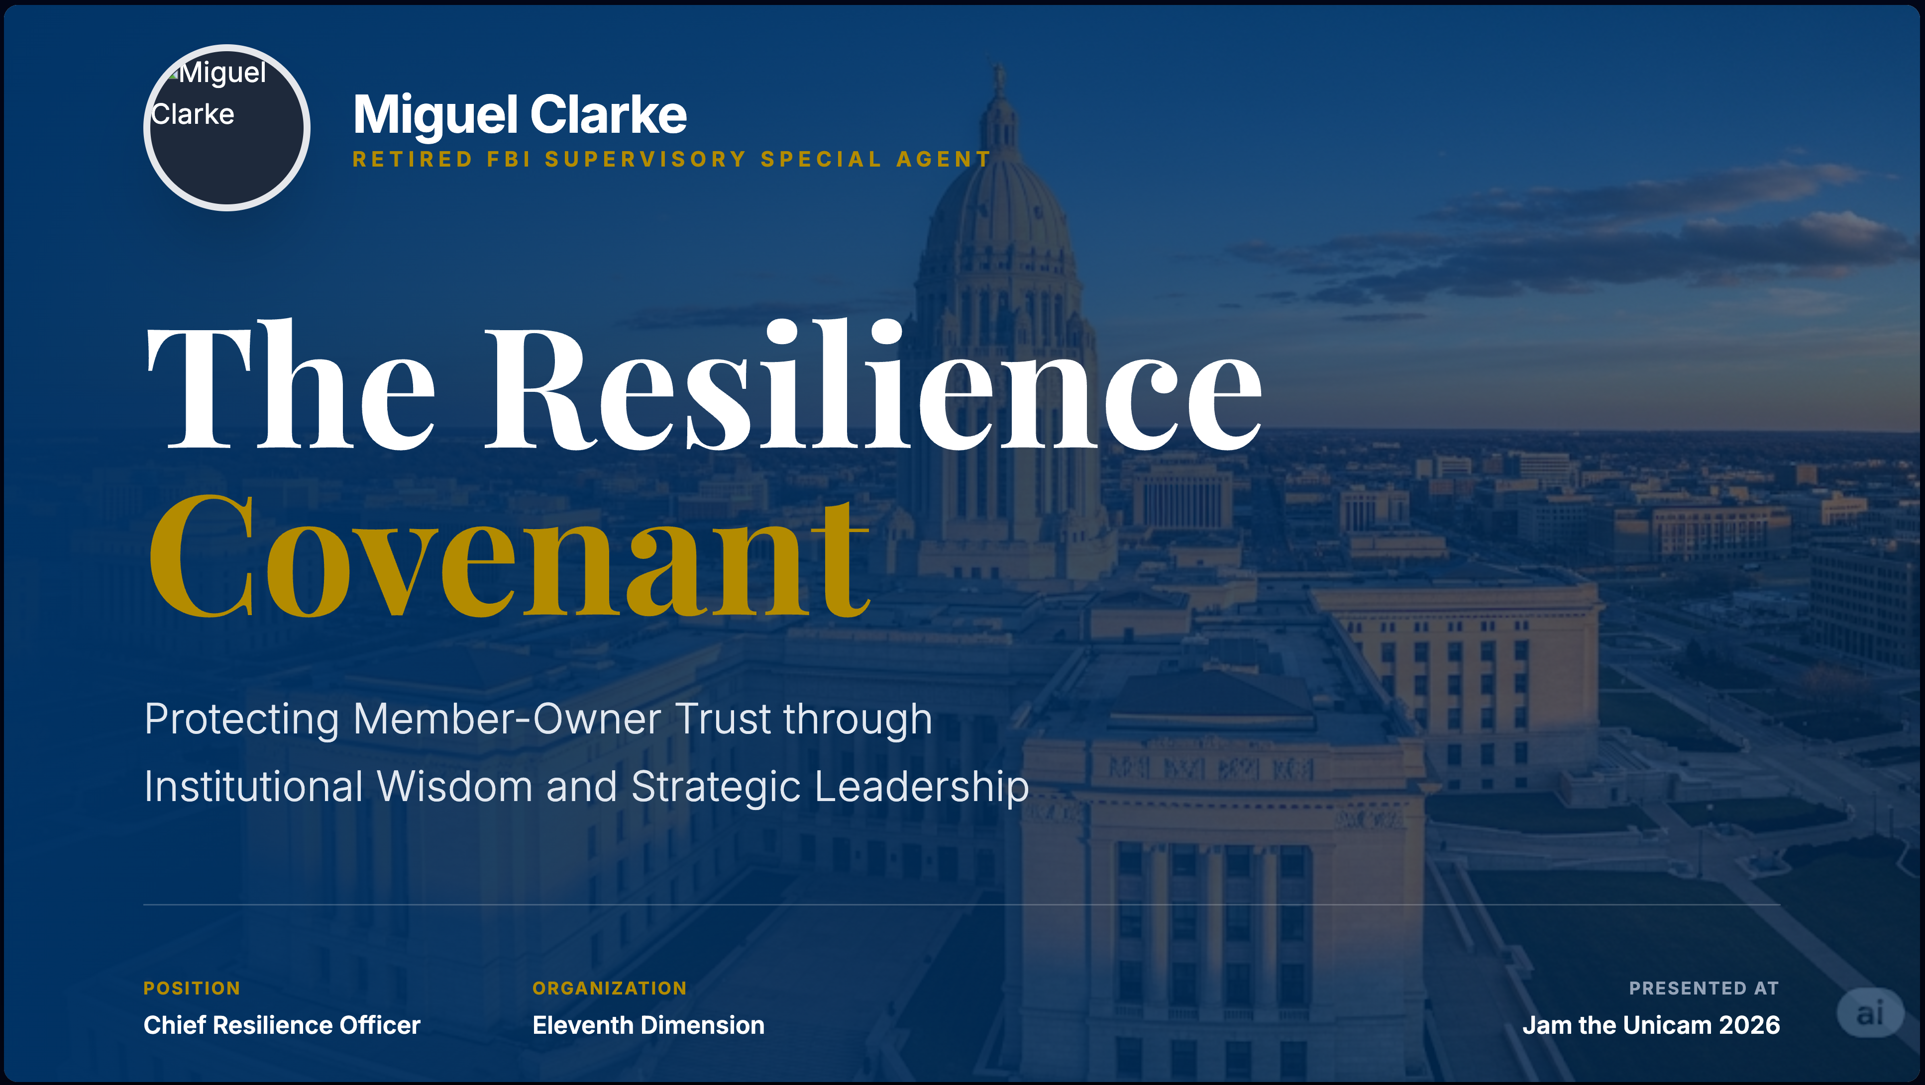
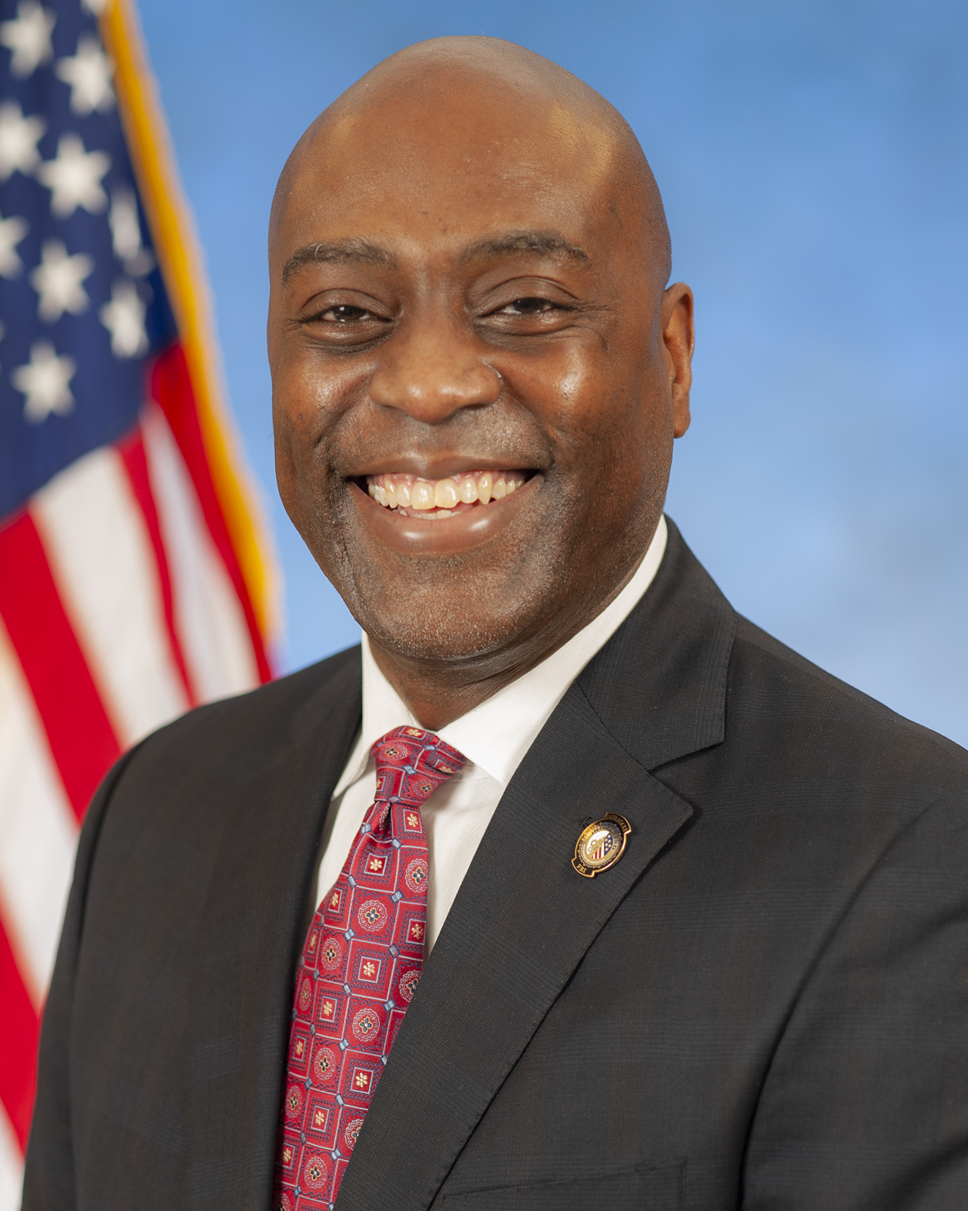
Notes:
Good afternoon,
My name is Miguel Clarke. I am the Chief Resilience Officer for Eleventh Dimension and a retired FBI Supervisory Special Agent. I am originally from the Bellevue, Nebraska area…well as much as any Air Force brat can claim to be from anywhere, at least.
My first office after graduation was FBI Dallas, where I spent most of my career. During my time in the FBI, I had the opportunity to work very interesting cases. Gangs, Drugs, and 9/11, of course. I was the case agent for the US Government’s efforts to protect the F-35 Joint Strike Fighter from cyber threats and I was the affiant for the Cyber Division’s first FISA warrant during time of the Google hack in 2010. I spent nearly 24 years in the FBI, most of which was with the Cyber squad.

Slide 3


The View from the Field
“In my 24 years at the FBI, I never once investigated a firewall failure.”
Every case was an investigation of human psychology, mismanaged risk, and a fundamental breakdown of institutional wisdom.
Intelligence Briefing
Notes:
The same hacker group can target 2 different organizations. One will suffer losses and be back to “normal” in 9 months. The other will go out of business. So, what is the difference between those two victims? The answer is resilience.
Look at the last sentence on this slide.
Psychology: paralysis & panic VS calm discipline
Risk: uncertainty VS confidence through preparedness
Wisdom: Making highly-defensible decisions under pressure.
In the FBI Academy, they used time pressure during firearms to help inoculate trainees against stress. It was cognitive load management (CLM).

Slide 4
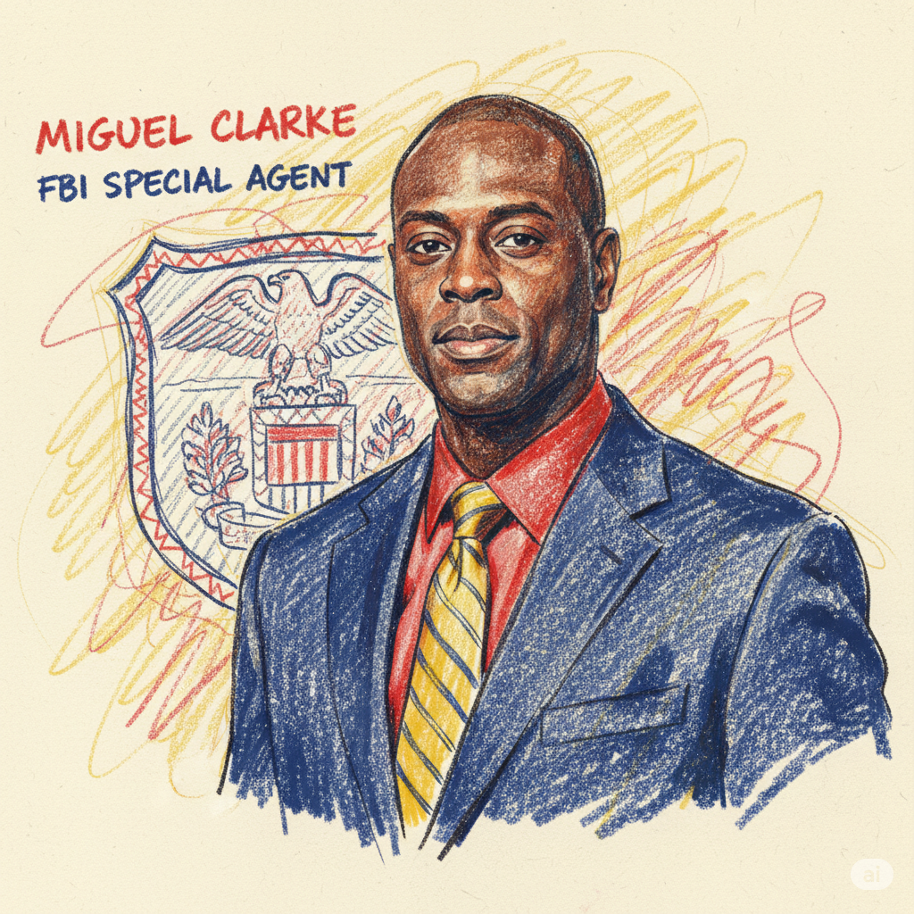


Covenant vs. Capital
The Bank Model
Transaction & Profit
Risk is a PR hurdle. Resilience is a balance sheet liability managed for distant shareholders.
The Credit Union Model
Relationship & Trust
Resilience is your commitment to the people who own you. Risk is not a technical number; it is a measure of your ability to keep your word.
That is not a simple PR nuance, it is a different species of risk.
Notes:
Back to risk. A significant part of your journey to resilience is “personalizing” risk. You paraphrase it so it’s not just text in your risk register spreadsheet.
You start to ask, what happens during a crisis?
Where are we strong? Where are we weak?
What tools, controls or conditions promote quicker identification and response to risk factors?

Slide 5
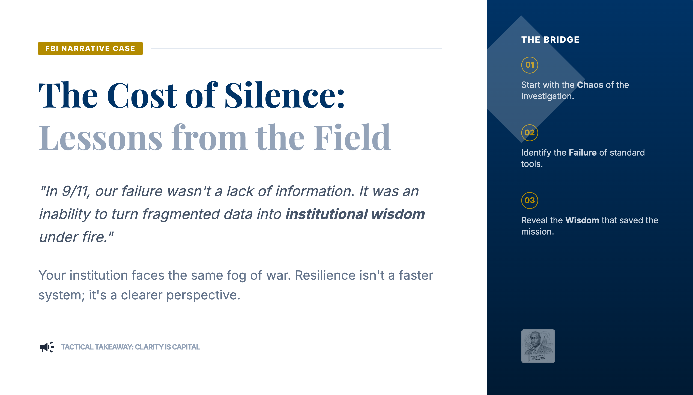
Notes:
Resilience is the ability to maintain the 'Shared Truth' when the systems that report the truth are under attack.
Crisis response is about people, not technology

Slide 6
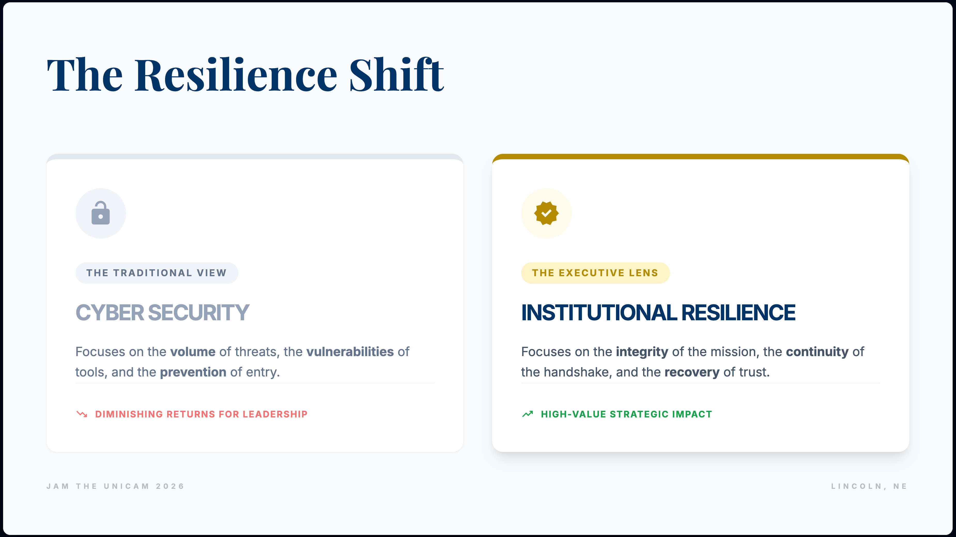
Notes:
Talking Points
"We have reached a point where more security tools do not necessarily mean more safety. This is the point of diminishing returns."
"I want to shift you away from the left side of this slide. The industry is obsessed with 'Cyber Security'—the technical wall. But as leaders, your concern is the right side: Institutional Resilience. This isn't just about stopping a hack; it's about the survival of the Handshake."

Slide 7
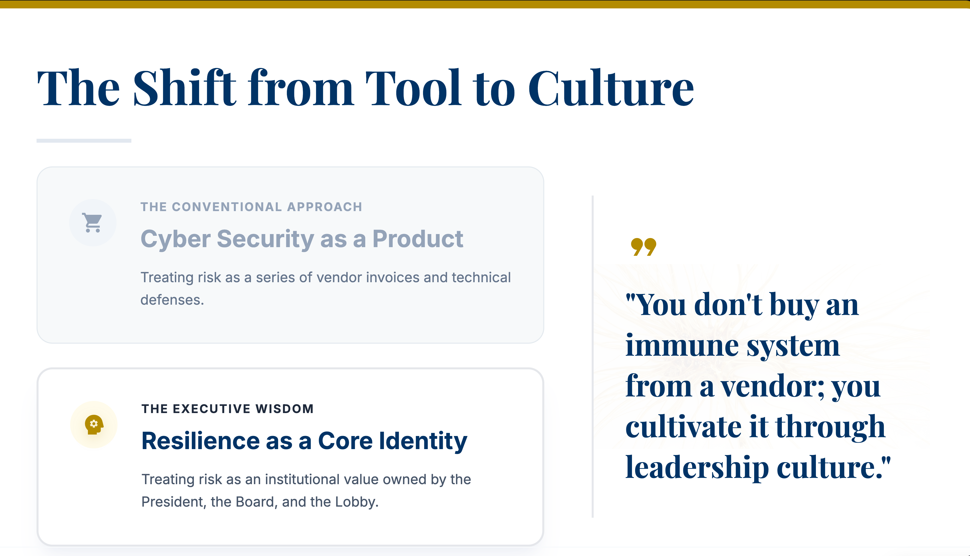
Notes:
"We’ve spent a decade believing that the next piece of software would finally make us safe. But if I learned anything in the Bureau, it’s that a tool is only as good as the culture using it."
"Think of your credit union as a living organism. When a virus enters, it’s not the exterior wall that saves you; it’s your internal immune system. And for a CEO, that immune system is your leadership culture.”
(Security is a people-problem. Most CEOs are much more comfortable solving people problems rather than than tech-problems.)

Slide 8
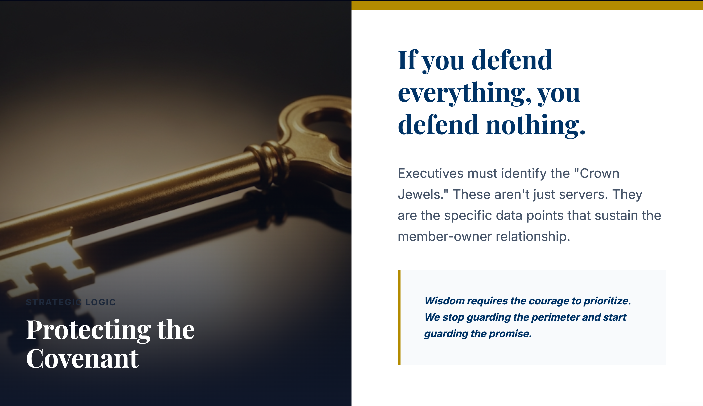
Notes:
Use this to talk about the Economy of Defense. Mention that in the FBI, limited resources meant we had to know exactly what the adversary wanted. Most IT teams try to boil the ocean. You are telling the CEOs: "Tell your teams what to protect first."

Slide 9
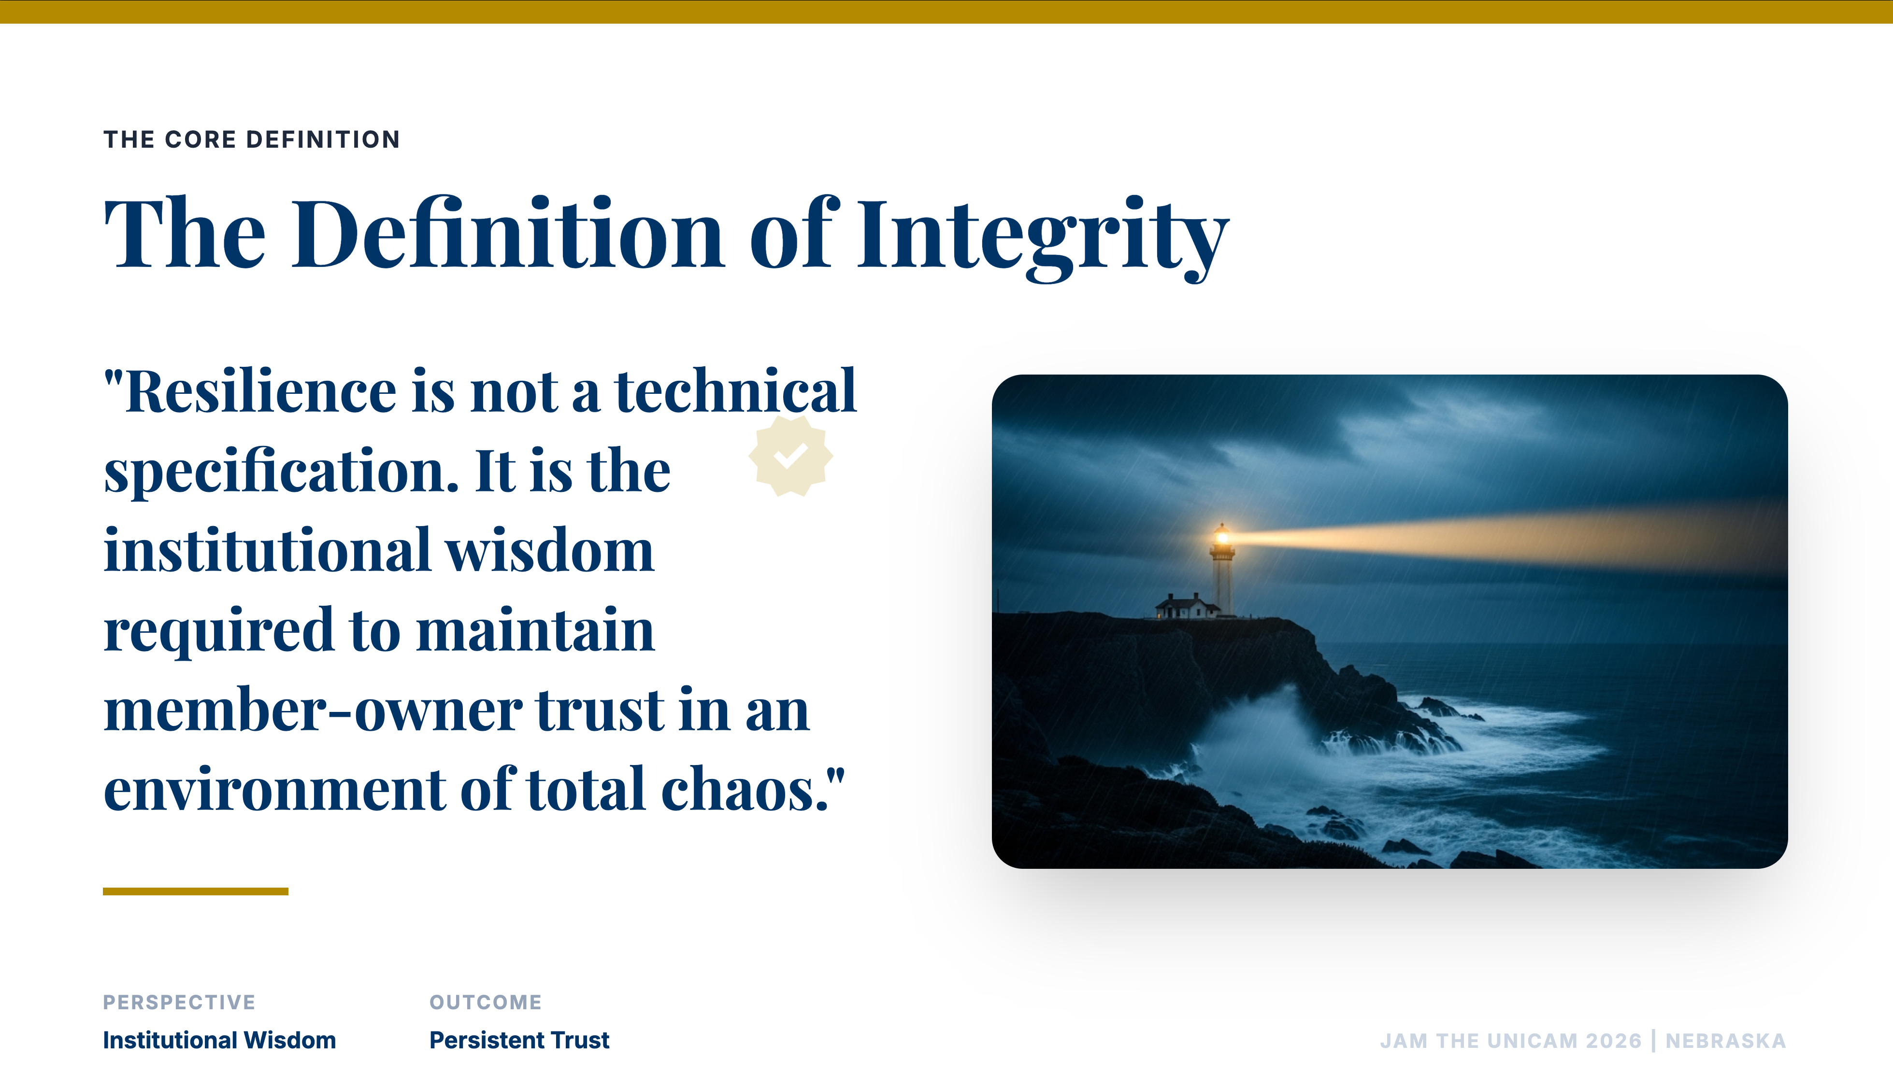
Notes:
This slide is meant to be stayed on for 2-3 minutes while you tell a story about a time the "tools" failed but the "wisdom" saved the case.
“Don't build bigger walls to stop the wind. Build houses that won't blow down.”
You can use a flood plain analogy. If you build in an area likely to flood, you will need to pay flood insurance.
Your members don't care about your firewall specs. They care whether they can access the services you offer when they need it. This is especially true when systems are down.
The industry obsesses over protection and prevention. Agentic AI for Defense and Threat Hunting, Post Quantum Cryptography, and AI-Resilient Zero Trust Architectures are all cutting edge tech.
Operational integrity is your institution’s capacity to function under duress. It is the fulfillment of the member covenant when the tools fail the team.

Slide 10



Beyond the Dashboard
The Cost of Silence
How long can our members wait before the covenant of trust is permanently broken?
The Crown Jewels
Are we protecting the perimeter, or are we obsessively protecting the data that makes us a credit union?
The Cultural Default
When the system stops, do our people default to following a manual or following the mission?
Technicians seek Data.
Leaders require Wisdom.
Notes:
Let’s take this beyond the technology dashboards.
During a breach or crisis most organization’s default to going radio silent

Slide 11
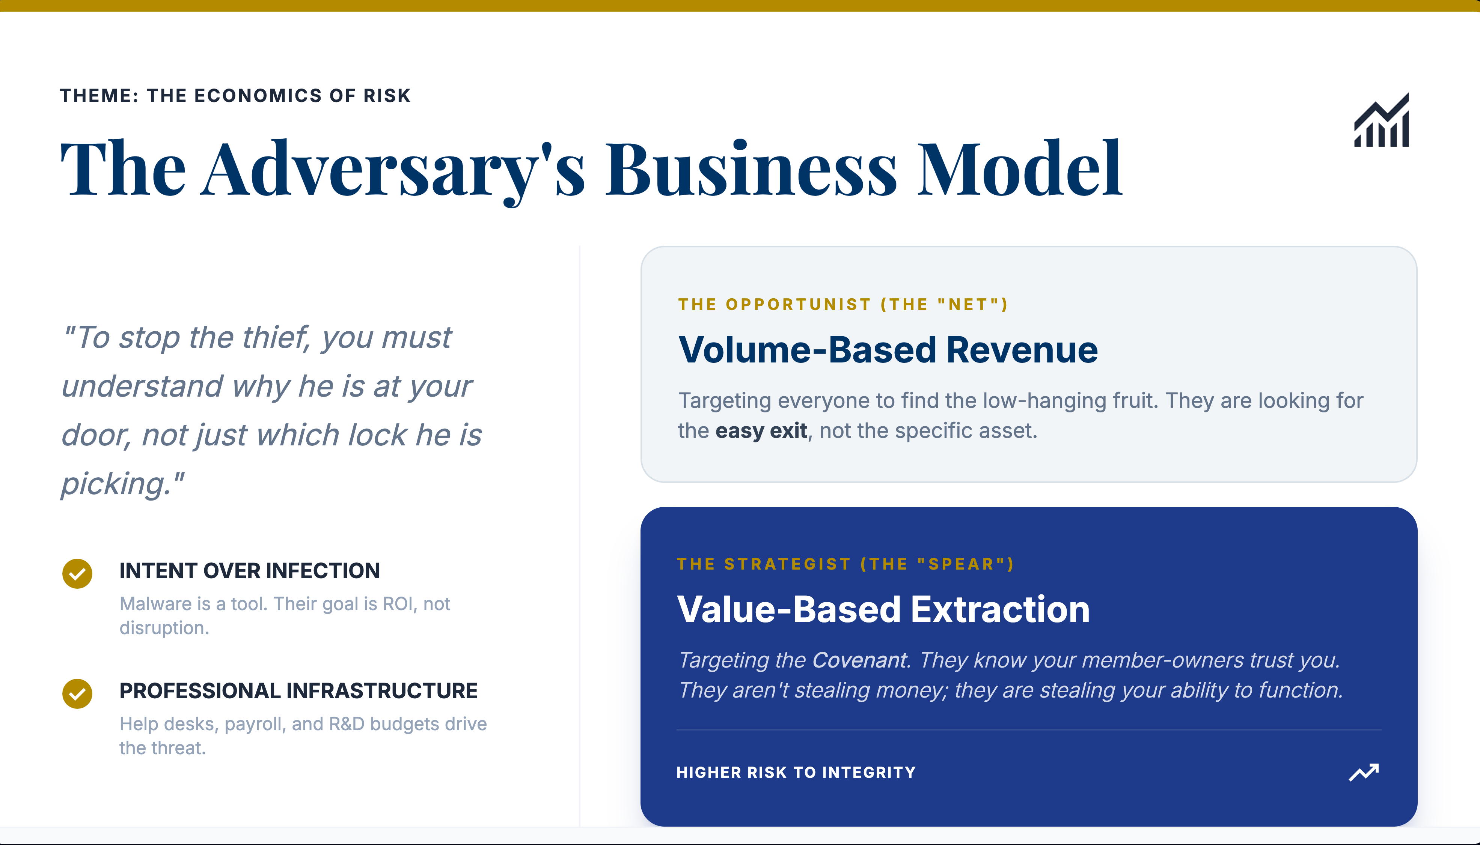
Notes:
Cyber Crime is not an industry. It is an entire ECONOMY. This is an evolution of how we perceive cyber threats.
Just like legitimate “Tech Sectors” the criminal industry has moved toward an “as-a-service” model.
This means they can Specialize, have Customer Support, and can Operate at Scale. If they can imagine it, they can do it.
That means they are more resilient than we are. An industry can be disrupted by targeting its CEOs or infrastructure. An economy is much harder to "kill" because it is decentralized.
At the end of the day, organizations are stuck using enterprise point solutions in an attempt to treat systemic risk endemic to any connected business operating in 2026.

Slide 12
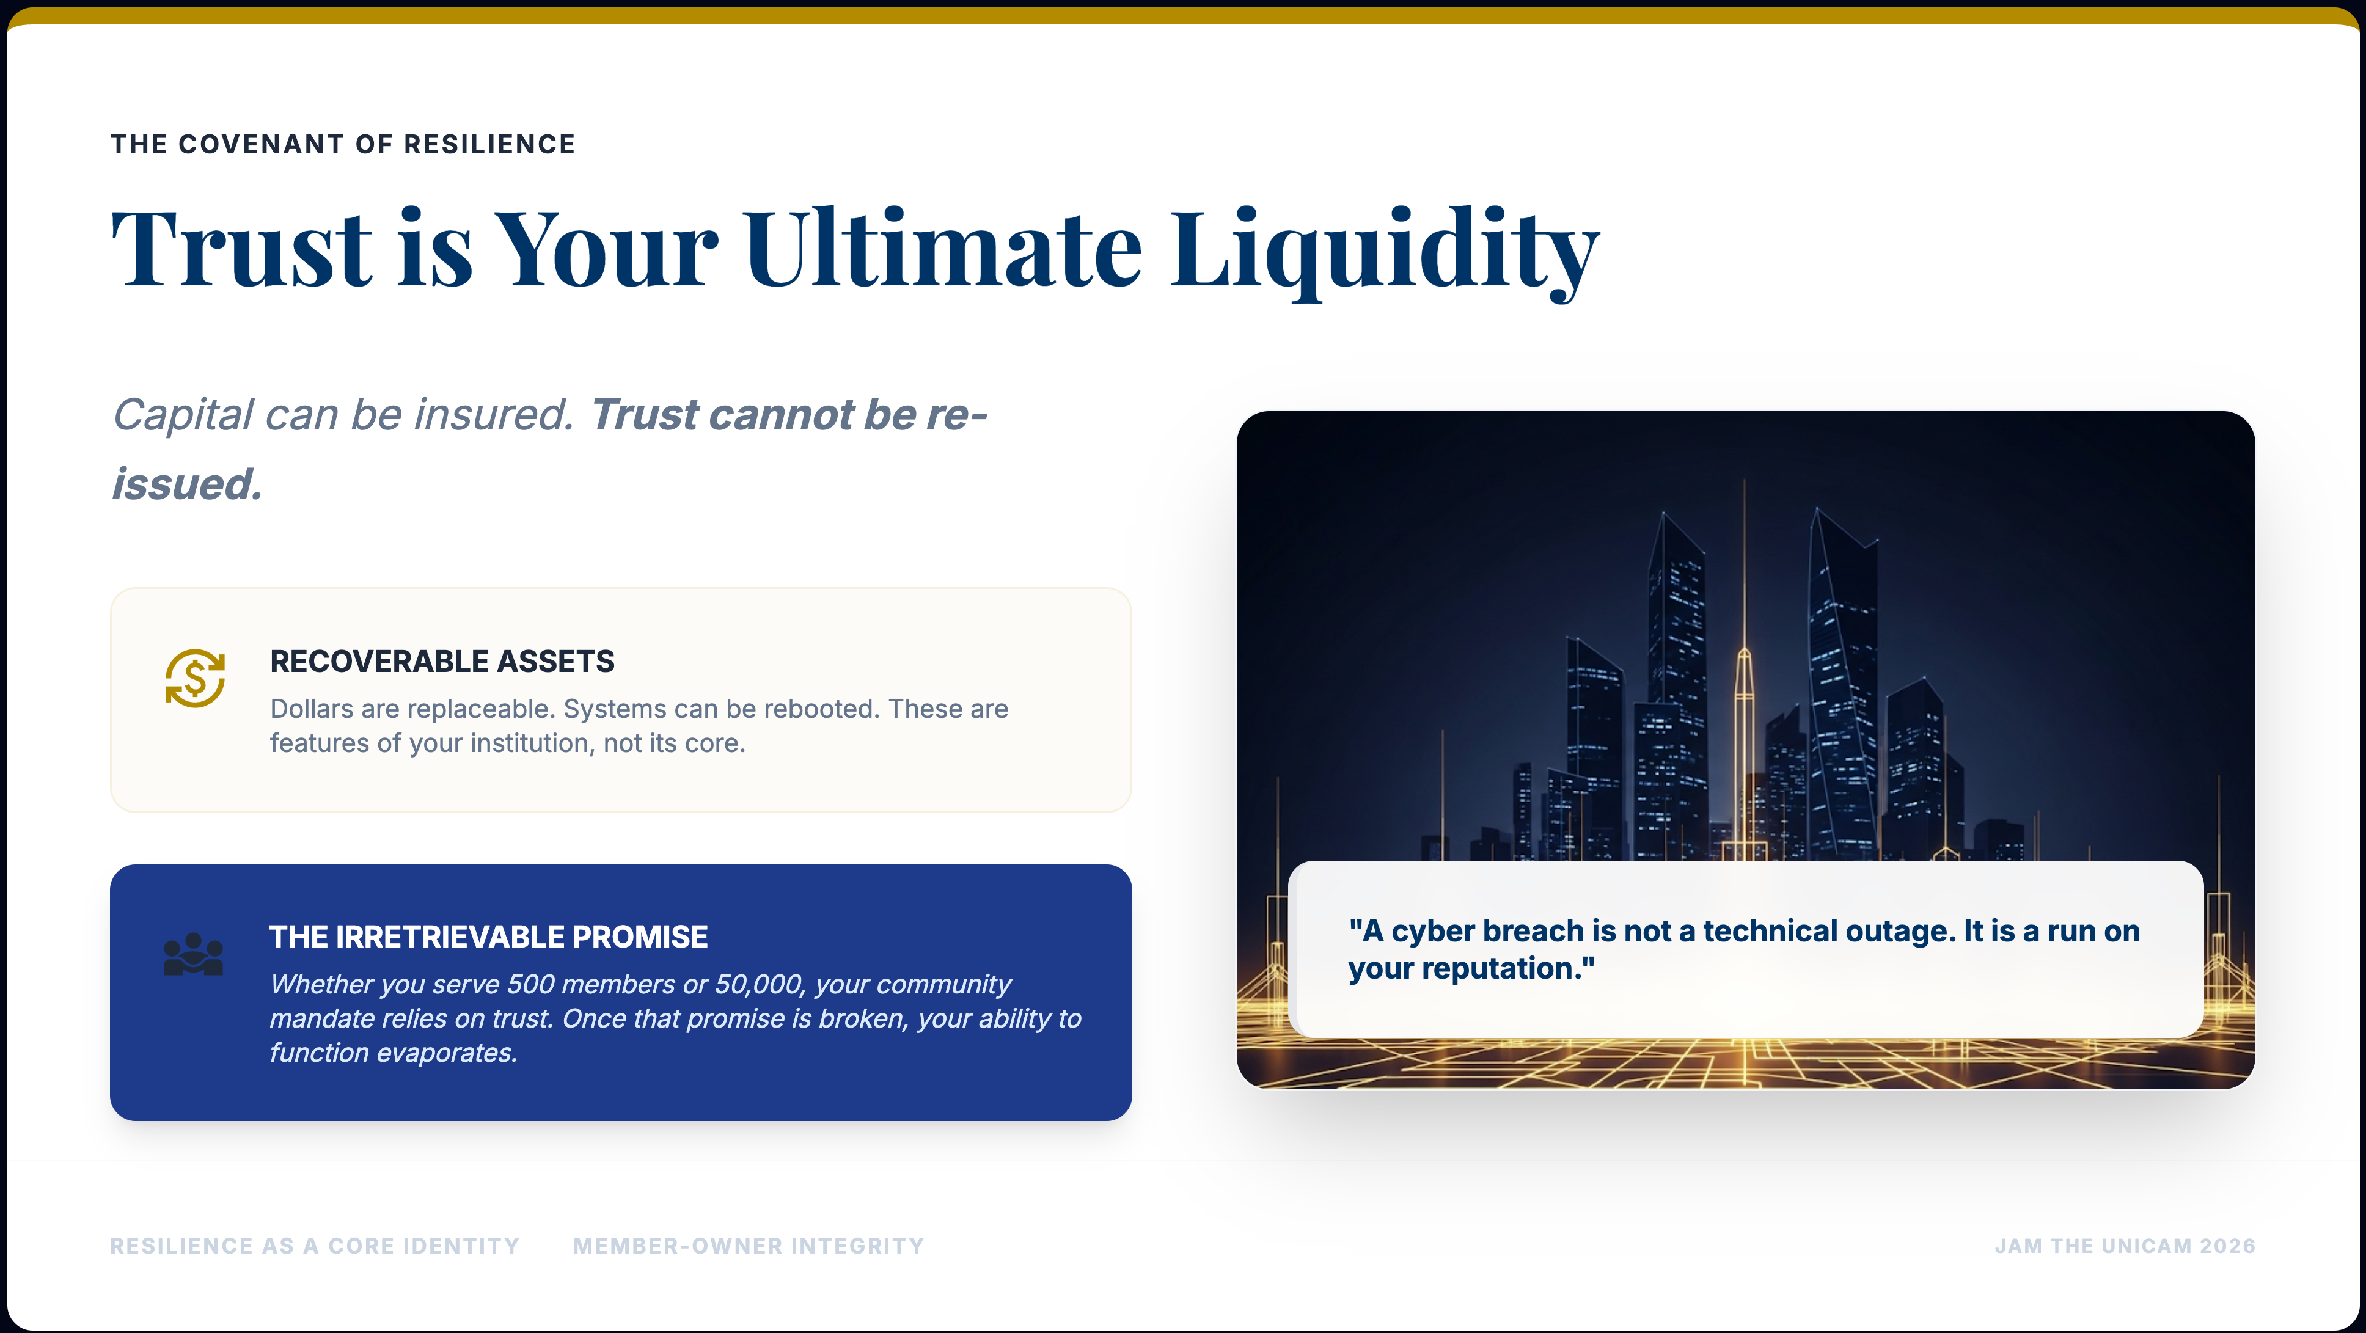
Notes:
The "Liquidity" Narrative
"You all understand liquidity. You know what happens when the vault is empty. But I want to talk about a different kind of liquidity: The Member-Owner Trust."
"In my time investigating major breaches, I saw companies survive million-dollar ransom payments, but I never saw an institution survive the loss of its soul.
For a Credit Union, trust is the only asset that actually matters. If the technology fails, your members need to know the person behind the screen still has their back.”
My hope is that executive leaders make a more direct connection between a breach costs and reputational damage. Reputational damage should be part of your conversations regarding risk appetite.

Slide 13
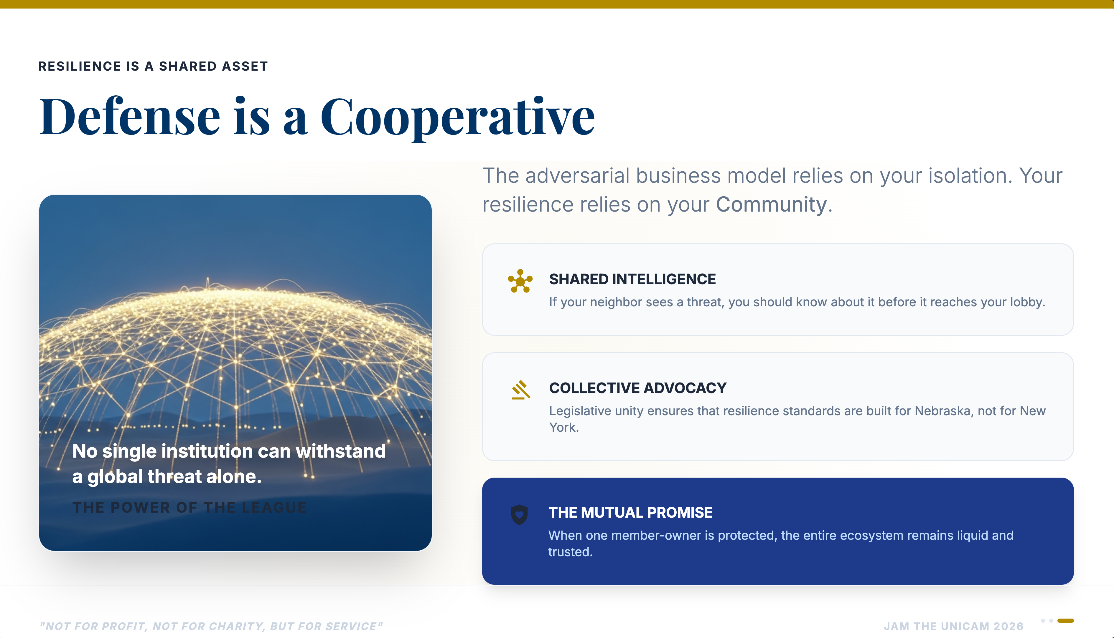
Notes:
The adversaries are working together but the victims are not.
You’ll need to decide how much sharing is too much sharing. Just understand that the adversary’s initial goal is to separate you from the pack.
It pacifies the target. Creates anxiety, if not outright panic. They are operating in their comfort zone and it is a disaster for the target.
These are the operational realities of a breach. They have first-mover advantage too.

Slide 14
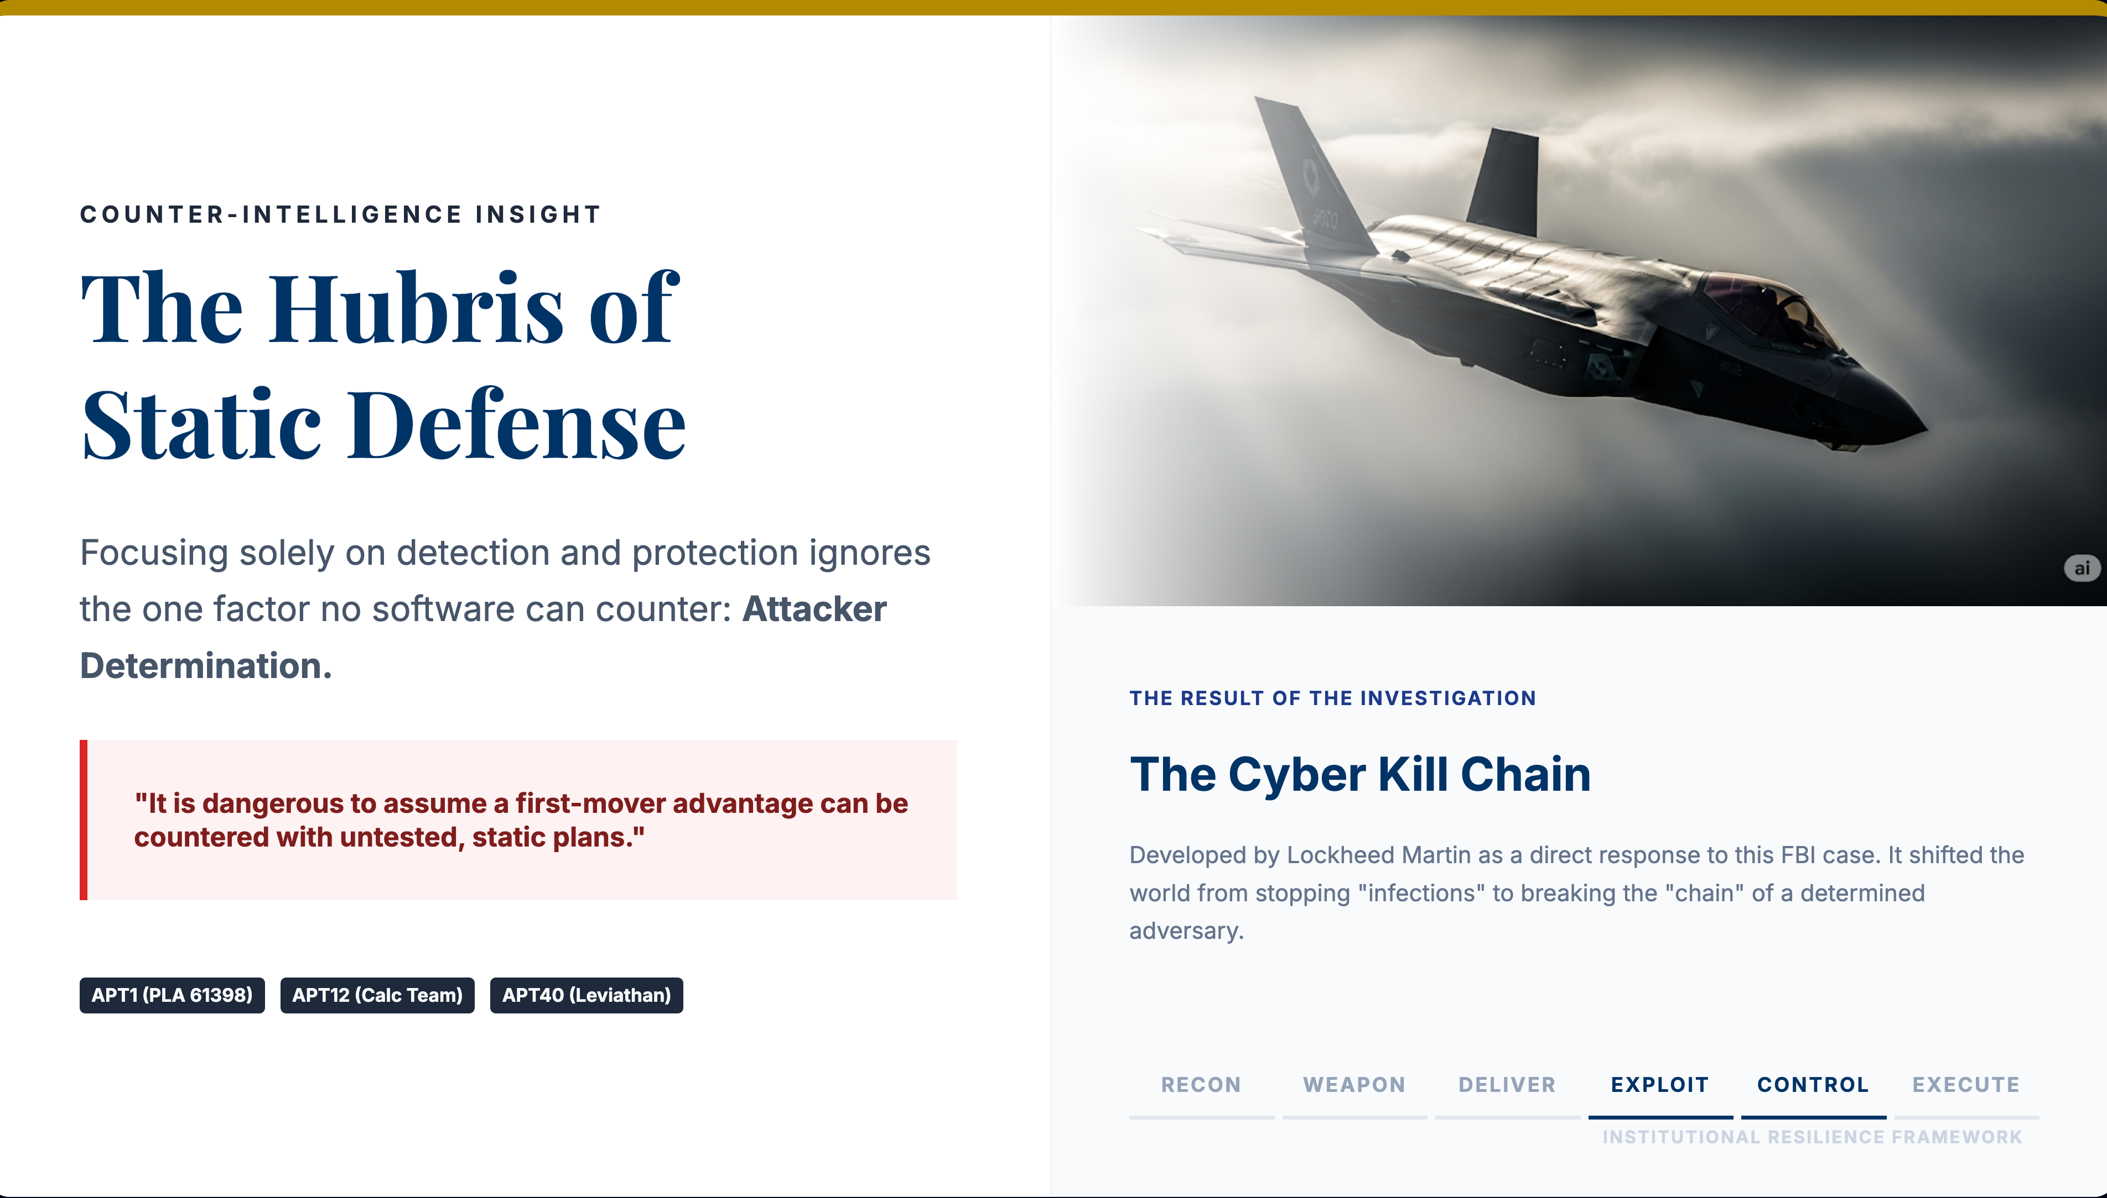
Notes:
Narrative Implementation
"In the early days of cyber-counterintelligence, we learned a humbling lesson during the F-35 investigation. We were up against the Comment Crew and Leviathan—state-sponsored actors with infinite patience and first-mover advantage."
"We realized that our static defense plans were essentially hubris. We were playing checkers while they were redefining the board. The Cyber Kill Chain was born from that failure. It taught us that resilience isn't about the wall; it's about identifying the sequence of an attack and having the determination to break it before the mission is compromised.”
Regardless of how good a boxer might be, he knows he is going to get hit during the fight. Effective training takes this into account before the engagement.
There is no system which is safe from a determined attacker.

Slide 15
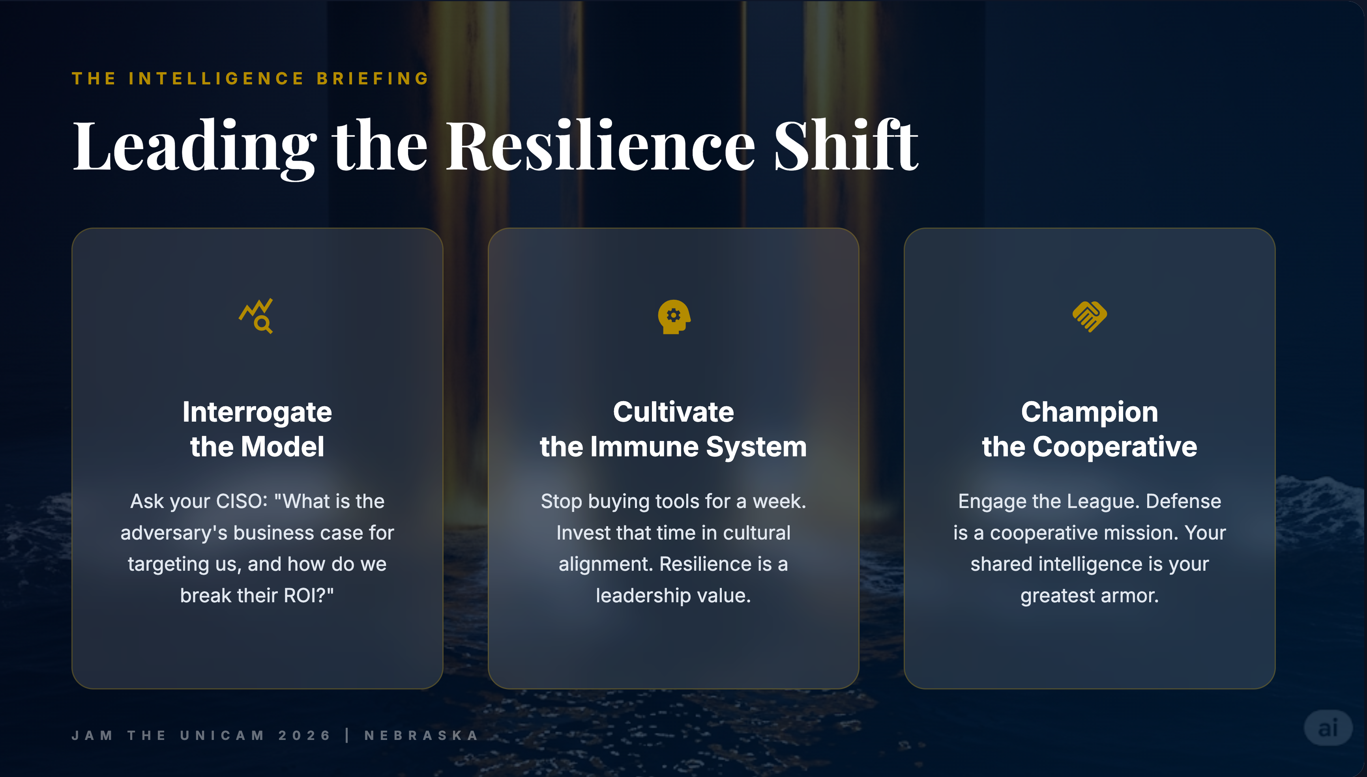

Slide 16
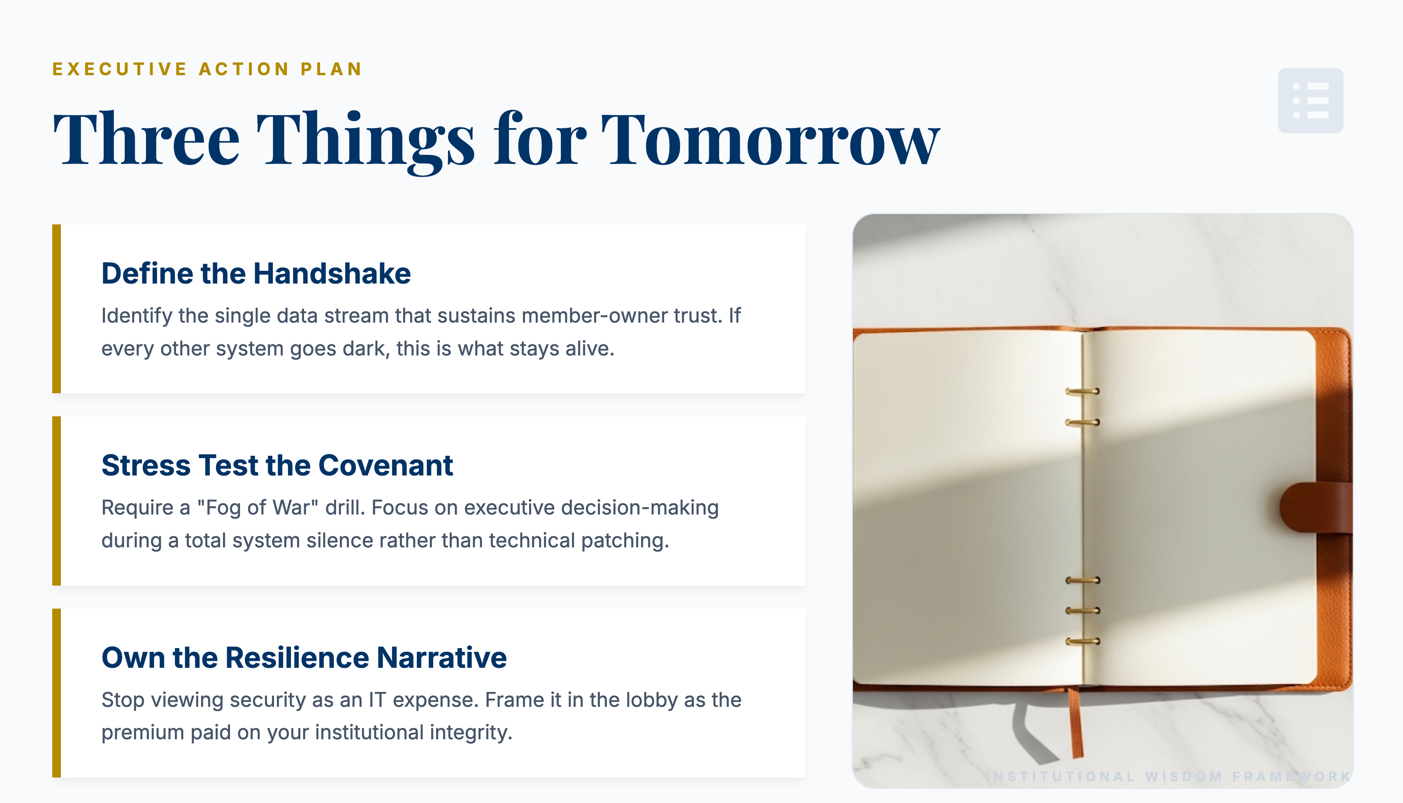
Notes:
(Enough with the bad news.)
We are all here now with an opportunity to make meaningful changes to the future of the organization.
Identify the “crown jewels”. That sounds so cliché at this point. What service or services represent the Minimum Viable Company?
Create a BC/DR and IR Team. If have one, start thinking about Tabletop Exercises around the decision-making function. Technology is great. But decisions in a crisis are really difficult to get right.
Security spend should buy a certain level of protection and/or performance. The most useful CEO conversations will shed light on how EFFICIENT and EFFECTIVE that security is.
The main question that customers will ask during an outage is when the expected systems will come back online. Everything else is just a reason, when they are looking for an answer.

Slide 17
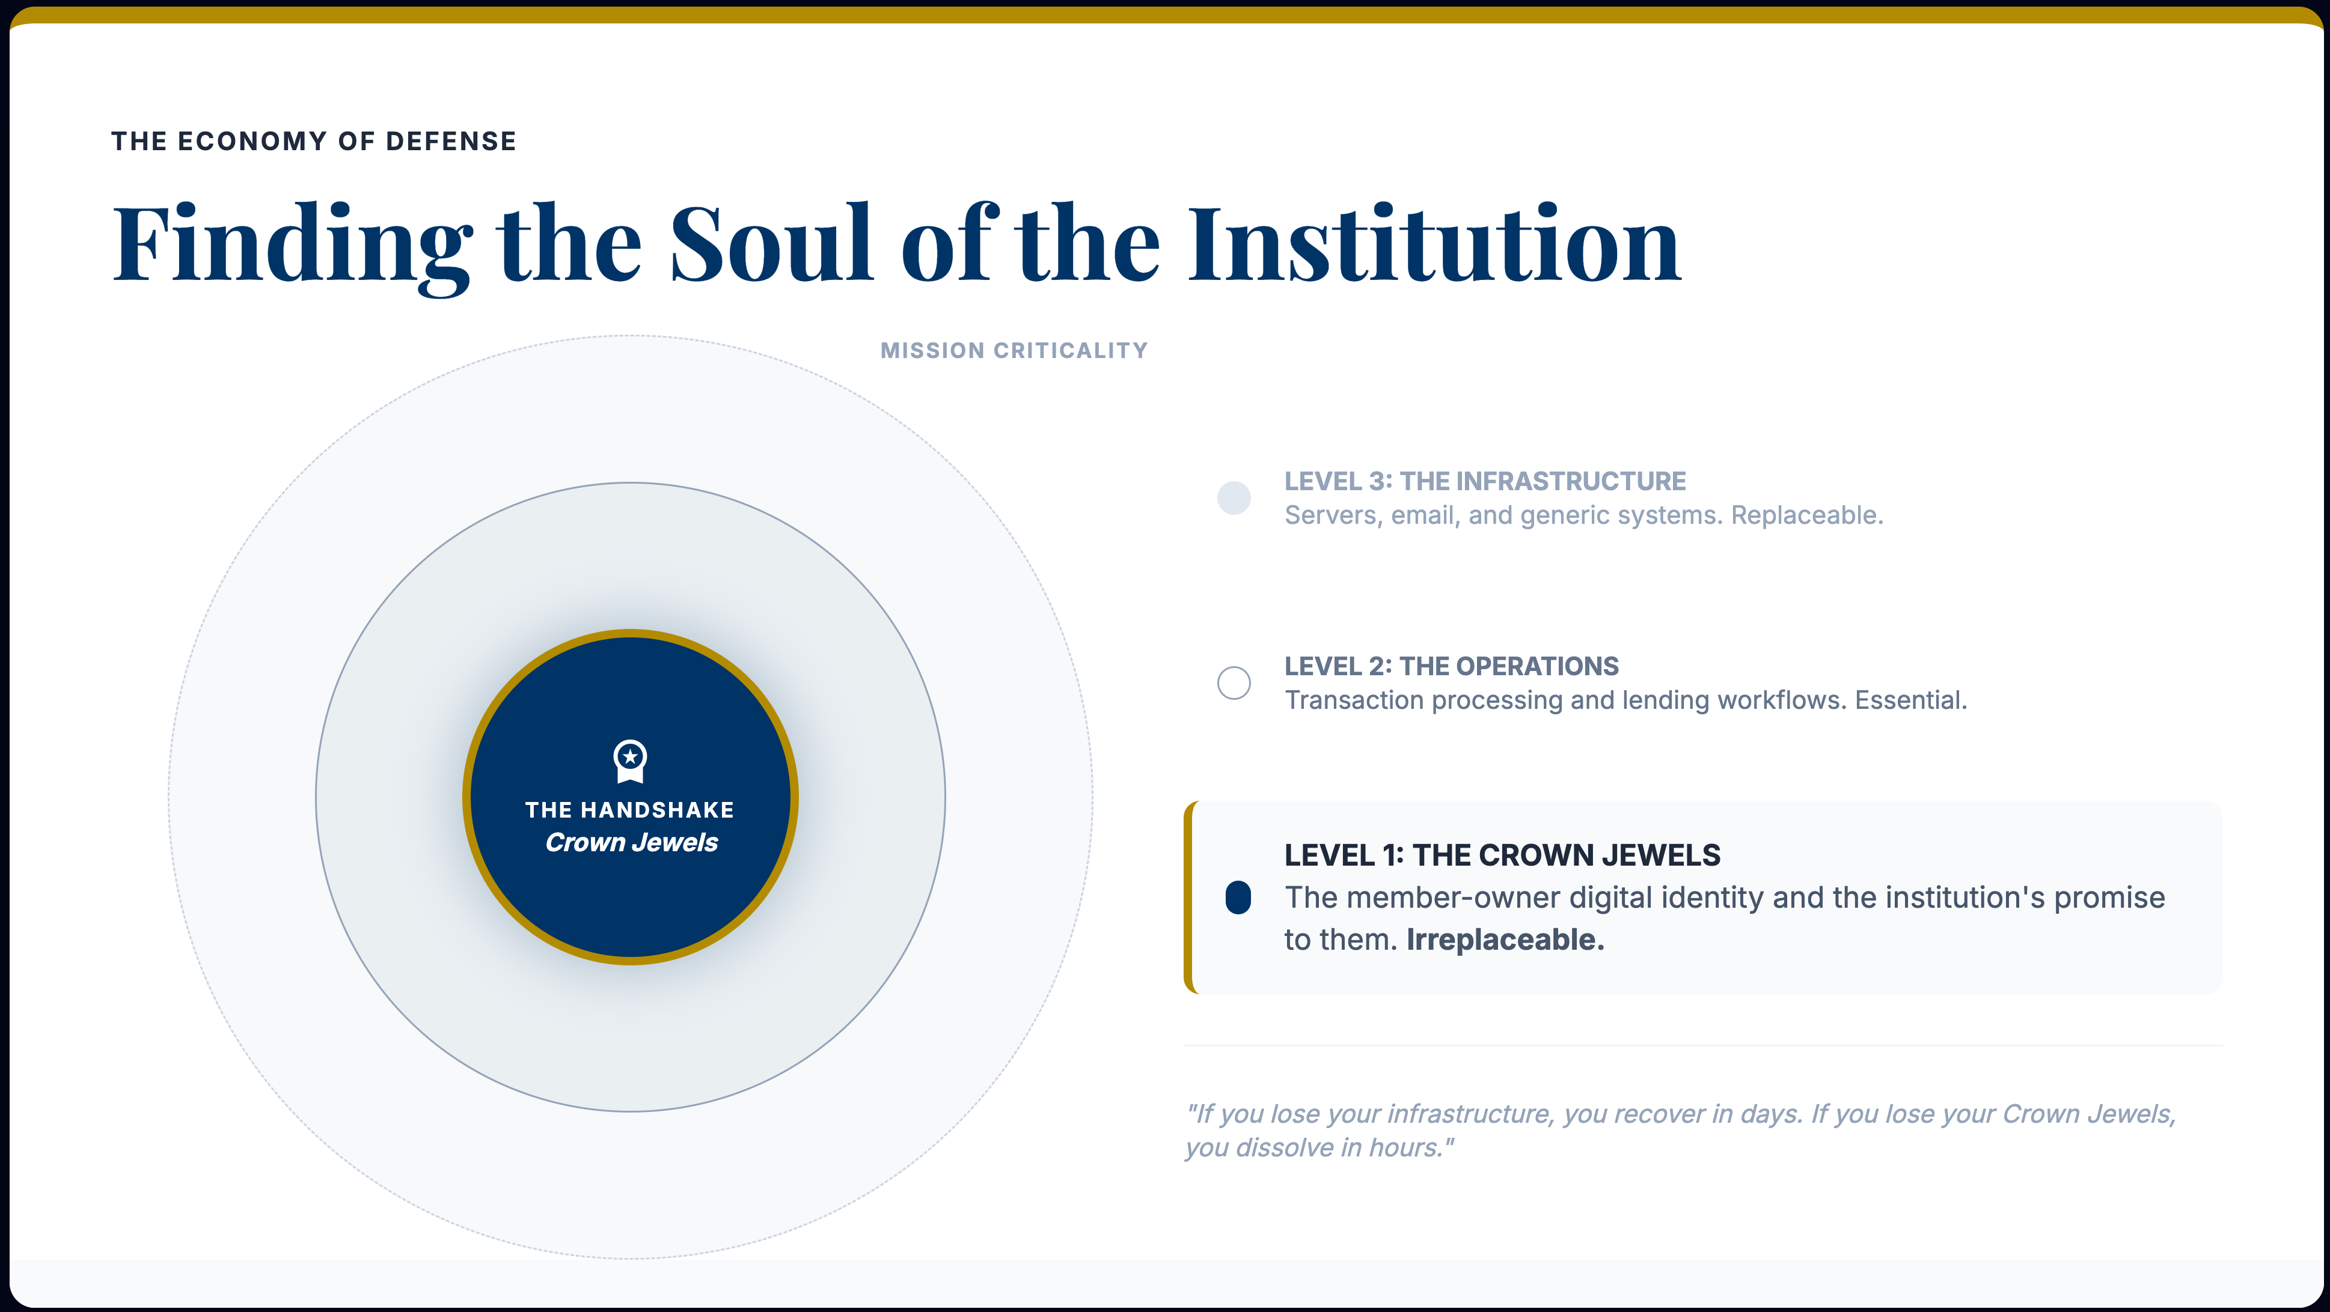
Notes:
You should modify significantly to focus on the Hierarchy of Mission. This slide is where you help the CEOs realize they have been defending the wrong things with the same intensity.
The Content Shift
•The Soul vs. The Skin: Frame Level 3 as the "Skin" (Protective but grows back) and Level 1 as the "Heart" (If it stops, the institution stops).
•FBI Parallel: Talk about how in espionage, we didn't care about the thief taking the laptop; we cared about them taking the source code. For them, the source code is the Member Relationship.
•No Technical Specs: Notice this mockup has zero mentions of "firewalls," "cloud," or "encryption." It's purely strategic.

Slide 18
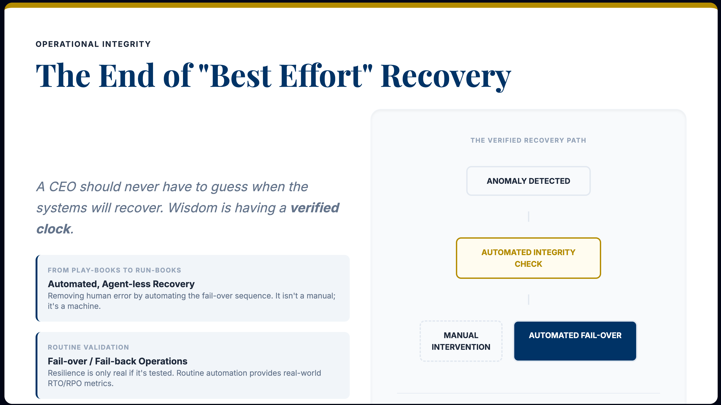
Notes:
The "CEO Lens" Narrative
•The "Guess" Problem: "I’ve seen CEOs standing over their CISO’s shoulder during a breach, asking 'When?' and getting a 'Maybe.' That isn't leadership; that's a hostage situation."
•The Value of Automation: "In the FBI, we didn't just have a plan; we had a drill. For you, resilience means moving from paper 'Play-books' to digital 'Run-books' where recovery is automated, tested, and verified."
•The Metric of Truth: "You should know your RTO as clearly as you know your net worth. It shouldn't be a projection; it should be a verified historical average from your last automated test."

Slide 19
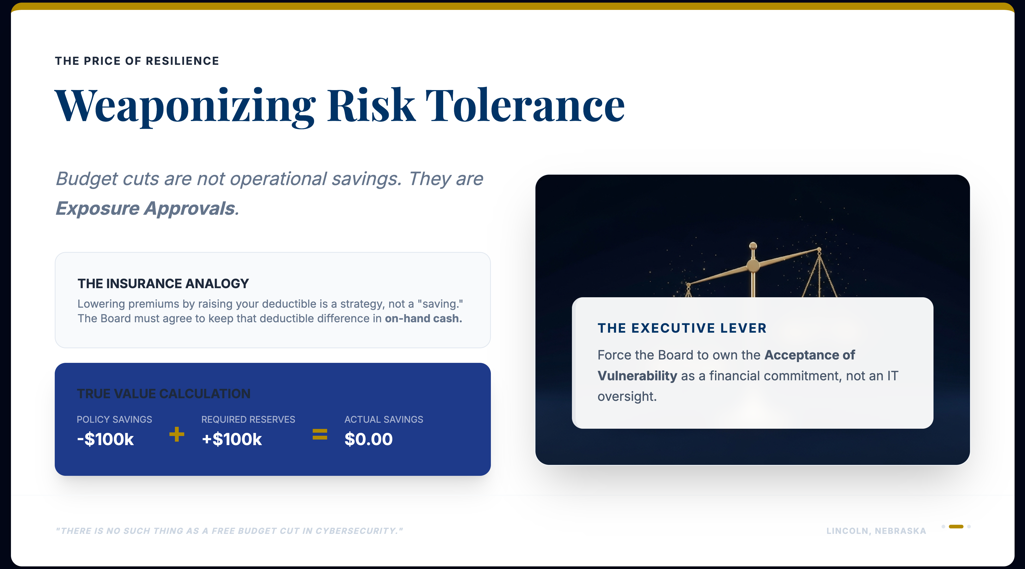
Notes:
The "Boardroom" Narrative
•Stop the "IT Ask": "Stop going to your Board asking for money. Start going to your Board to present their options for Risk Retention."
•The Honest Broker: "If we cut our cyber budget by 20%, we haven't saved a dime. We have simply transferred that $200k from a 'defensive asset' to a 'retained liability.' Is the Board prepared to hold that cash in reserve tonight?"
•The Weapon: "When you weaponize risk tolerance, you turn the budget conversation into a Choice of Coverage. This is how you lead through the financial fog."

Slide 20
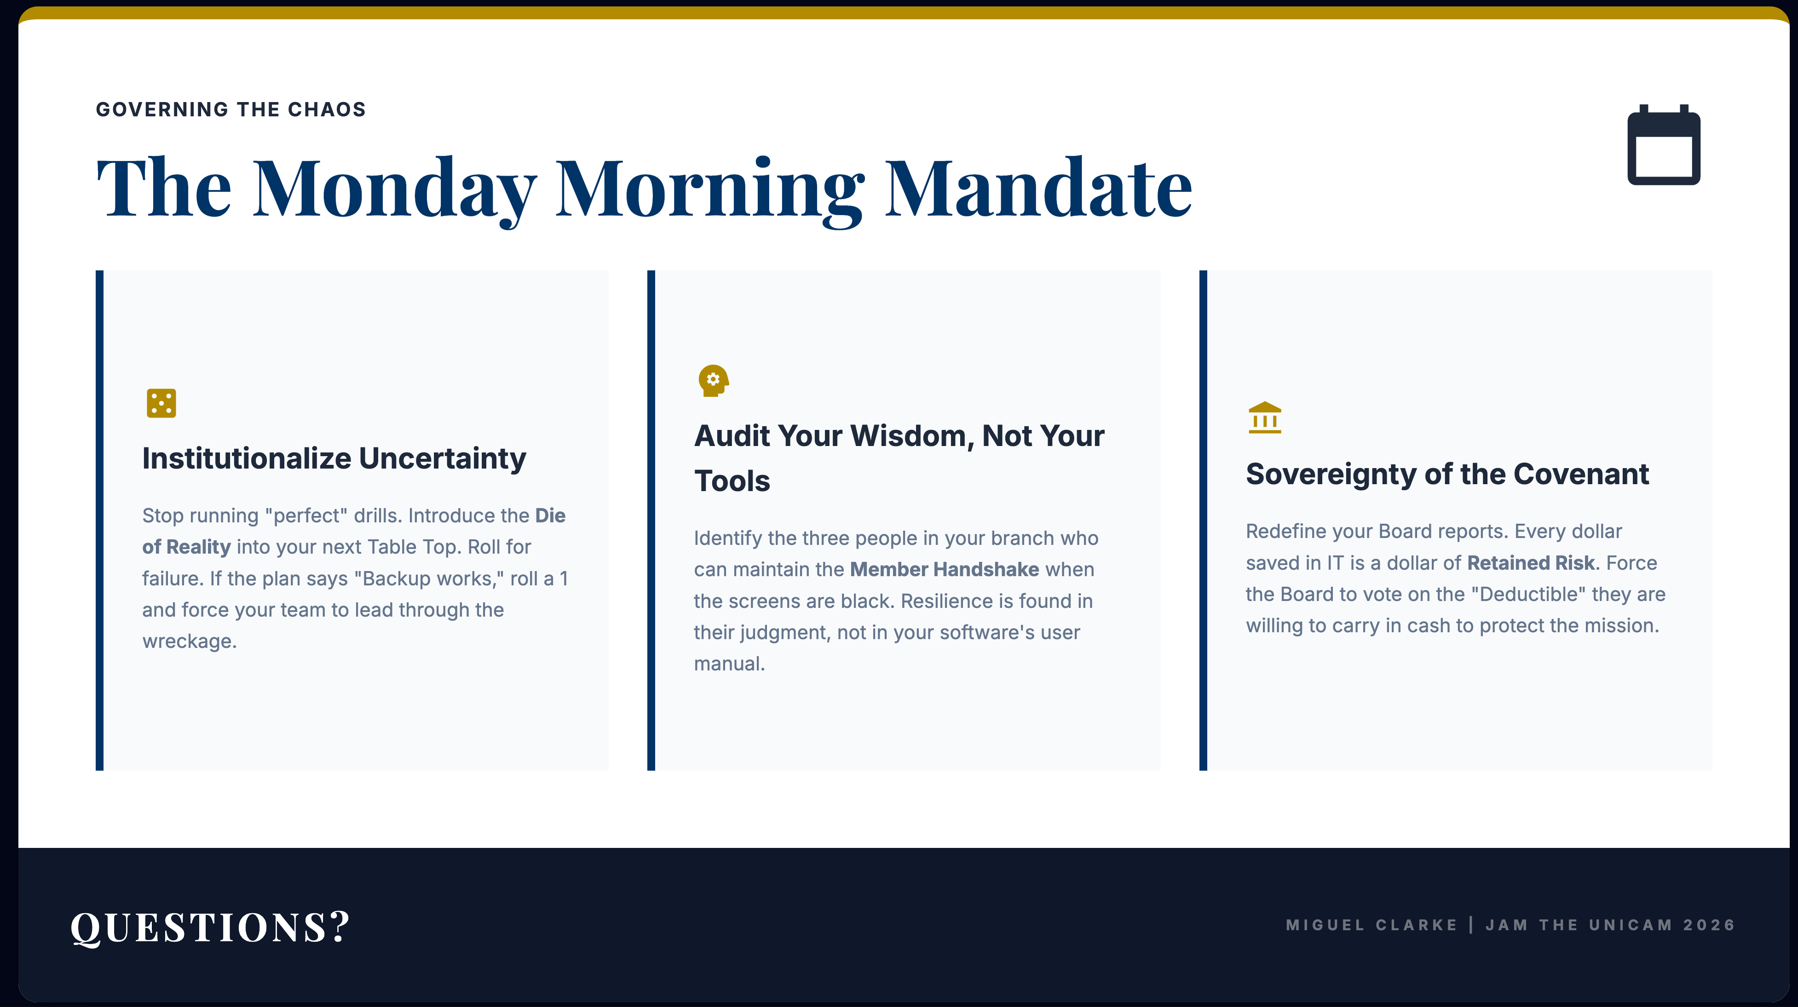
Notes:
“I spent more than 2 decades in the dark, so that you can lead your institutions in the light.”
Do what AP Tabitha Clarke does. Make the drill realistic. Why should the fire drill happen at the prefect time?

Slide 21
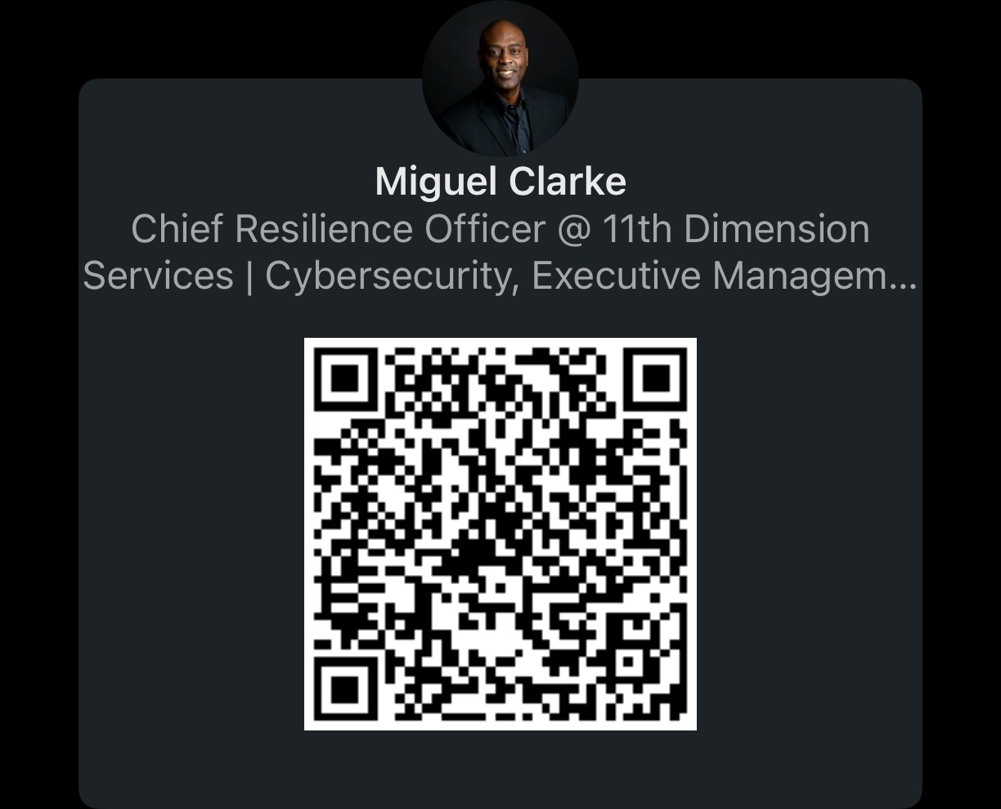
Thank You
📧 miguel.clarke@eleventh-dimension.com
"Beyond the Breach: Resilience as a Core Identity"

