Slide 1

Nebraska Credit Union League
2026 Comments by NDBF Director Kelly Lammers

Slide 2
Thank you, Nebraska Credit Union League
Thank you, Nebraska Credit Unions
Agenda
Statistics:
The Story Of Numbers: Levels, Trends and More
Legislative Agenda:
Separating the “We Did It That Way” From “The Why” At A Community Scale
World of Regulation from NE Perspective:
Law Requires NE Examiners To Be Constructive
Stablecoin:
Fixing The Security Of Moving “Rights” To Funds

Slide 3
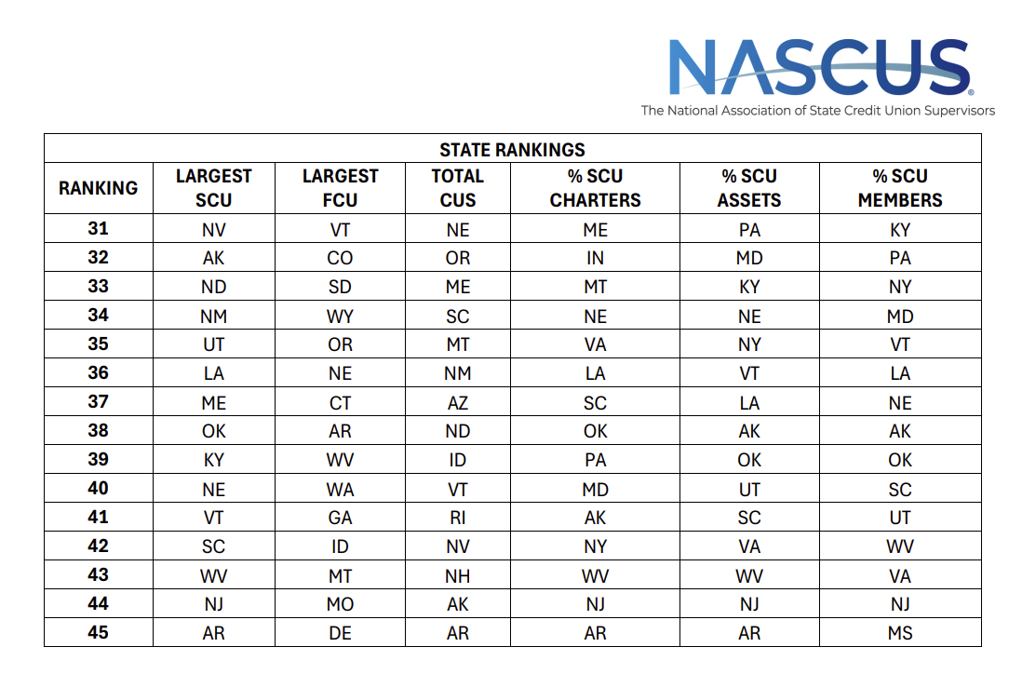







Slide 4

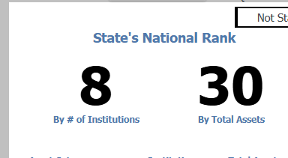



Slide 5
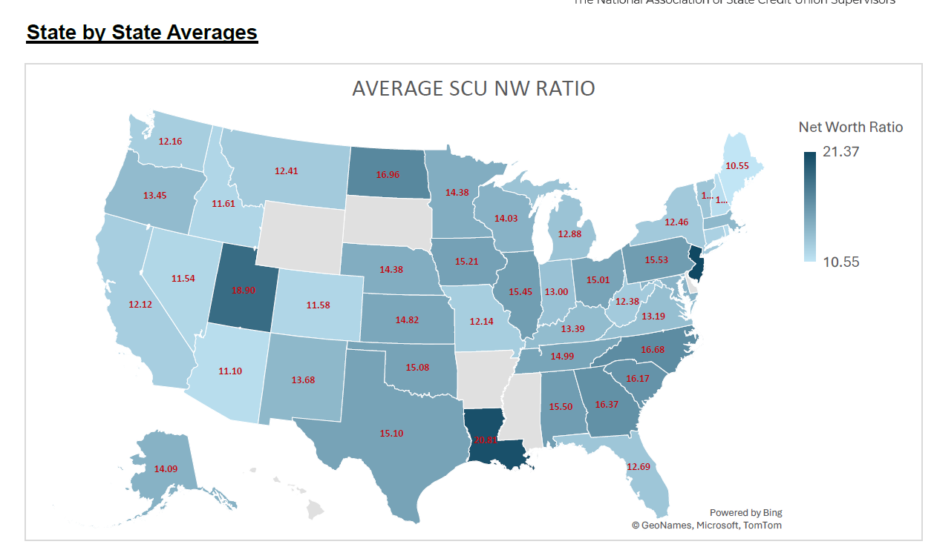

Slide 6
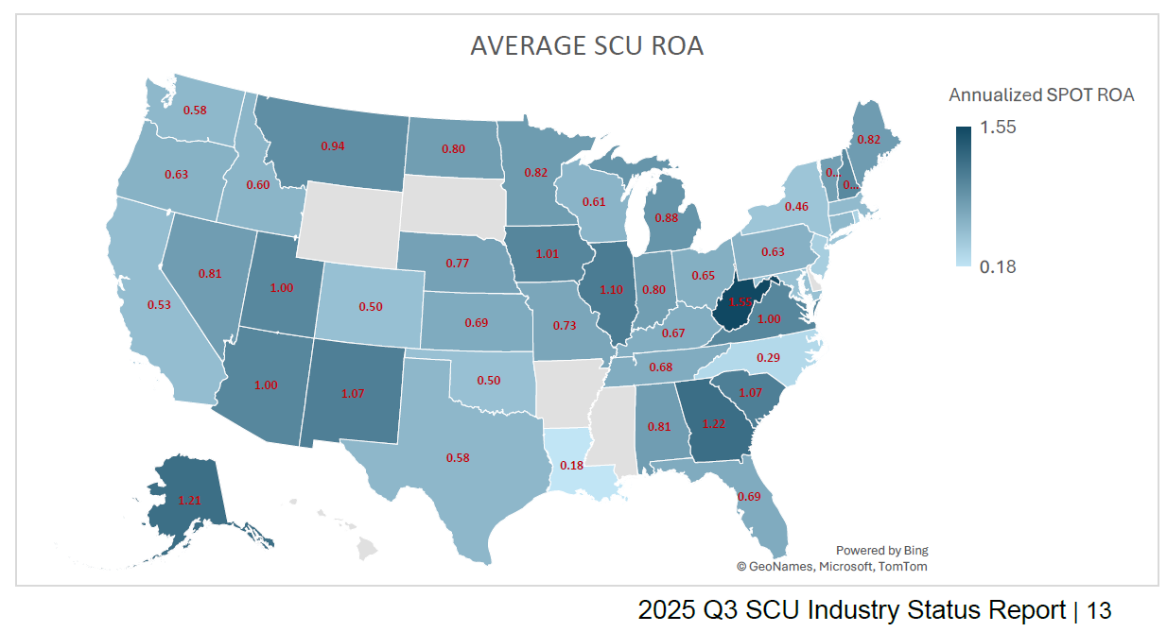

Slide 7
Nebraska “Variety”

Slide 8
Moving Away From Numbers to the Words

Slide 9

Legislative Agenda
LB 717: Hearing 1/20/2026
LB 836: Hearing Not Yet Scheduled

Slide 10
LB 717
Wild Card:
Time Begins With “Substantially Complete”
Change Installment Loans Monitoring Ceiling To $100,000
Net Tangible Benefit

Slide 11
LB 717
Wild Card:
Time Begins With “Substantially Complete”
Change Installment Loans Monitoring Ceiling To $100,000
Net Tangible Benefit
GENIUS Act:
Adds Credit Unions As Financial Institutions
Gives NDBF Director Ability To Define Capital

Slide 12
LB 836
Move away from “billable time” to an assessment based upon asset level (depositories) or volume for mortgage bankers, MT, etc.
No change in revenue.

Slide 13
Other bills
LB 837 – Working To The Penny Without Pennies
LB838 – Financial Institution Designation Of Authorized Contact

Slide 14
Stablecoin
What Is It?
What Does it Do?
Who Wants It?
HOW CAN WE MAKE IT WORK?

Slide 15

What Nebraska Needs

Slide 16
Thank you!
Kelly Lammers, Director
Nebraska Department of Banking and Finance
Telephone 402-471-2171
Web: ndbf.nebraska.gov
Deputy Director: Darcy Bailar
Legal Counsel: Will Lawrence
Review Examiner: Brody Focken

