Slide 1



Risk & Compliance Solutions | RiskConsultant@trustage.com
E m e r g i n g r i s k s o u t l o o k
Fraud trends
Proprietary and confidential. Do not distribute.

Slide 2


Losses
on the radar
While each credit union has its own unique risk footprint,
these fraud risks and trends should be on your radar
Account takeovers
Interactive Teller Machine (ITM) fraud
ATM/ITM jackpotting
Fraudulent checks/deposits
Fraudulent checks clearing member accounts
Fraudulent business accounts
Proprietary and confidential. Do not distribute.
2

Slide 3
Account takeovers
Proprietary and confidential. Do not distribute.

Slide 4

Account takeovers
Multiple 7-figure losses reported
Social engineer members out of login credentials
Social engineer call center employees into resetting member passwords and changing member contact information
Enroll member accounts for online banking
Enters member’s personal information – name, account #, address. mail address, phone number including mobile #
Hacks member email accounts to intercept online banking enrollment passcode needed to complete enrollment
Funds transferred to money mules
4

Slide 5

Money mule role in laundering stolen funds
Proceeds
Network
Funding
Wire fraud
BEC
Fraudulent instruction
Account takeovers
Fraudulent checks
Money mules
Funds sent to fraudsters
Transfer
Transfer
Transfer
Fraudsters recruit money mules to help launder proceeds derived from criminal activities
May open fraudulent accounts using synthetic identities
Adds layers of recipients to the money trail
Complicates law enforcement’s ability to trace money from a victim to criminal actor

Slide 6
Account takeovers
Deploy tactics from the traditional Zelle fraud scam
Variation of scam
Text messages contain a link to spoofed website – CU online banking login
Members click on the link and enter
login credentials
Fraudsters used credentials to immediately login to member accounts
2-factor authentication passcode delivered to members
Members entered passcode to the
spoofed site
Fraudsters grab passcodes to complete login to member accounts
Fraudsters transfer funds to external money mule accounts
Members receive account alert via text message appearing to come from credit union – suspicious debit card transactions
Fraudsters call members who respond to the text spoofing the credit
union’s phone number - claims to be from CU fraud department
1.Fraudsters con members into providing usernames (to verify identity)
Fraudsters con members into providing passcodes (to verify member’s identity)
Fraudsters use passcode to reset member passwords
Fraudsters login to member accounts and transfer funds to external money mule accounts
2.Fraudsters use the “forgot password” feature triggering a passcode and sending it to a member’s mobile device
Another variation of the scam has fraudsters skip sending fraudulent text alerts and proceed directly to calling members spoofing the credit union’s phone number to scam them out of their login credentials.

Slide 7
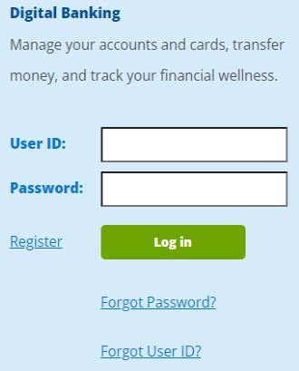

$2M account takeover fraud loss
Members received a text alert appearing to come from the credit union –
suspicious debit card transactions
Members responding to the text received an immediate call from the
fraudsters spoofing the credit union’s phone number
Fraudsters claimed to be from the credit union
Fraudsters conned members into providing their online banking usernames –
to verify their identities
Fraudsters used the usernames with the “forgot password” feature – triggering
a 2-factor authentication passcode to members
Members conned into providing the passcode to the fraudsters – to verify their identities
Fraudsters used the passcodes to reset members’ passwords
Logged into accounts and used A2A/external transfer service to transfer funds to external money mule accounts - $2M in transfers in less than 2 weeks
Credit union disabled A2A/external transfer service and the fraud stopped

Slide 8
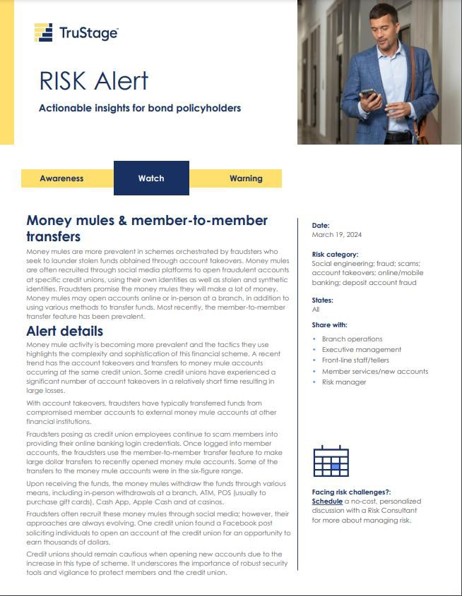
Account takeovers/money mules
Recent
trend
Account takeovers & money mule accounts at the same credit union
Fraudsters recruit money mules to open fraudulent accounts at target credit union
Social engineering attack launched against existing members to scam them out of their login credentials once the mule accounts are opened
Fraudsters use member-to-member transfer feature to make large dollar transfers from compromised member accounts to the money mule accounts
Money mules withdraw funds through various means

Slide 9
$2.5M account takeover fraud loss
Fraudsters recruited money mules to open accounts at the credit union
Fraudsters called existing members spoofing credit union’s phone number claiming to be from credit union’s fraud team
Conned members into providing usernames that fraudsters used with the
“forgot password” feature
Triggered 2FA passcodes to members – provided to fraudsters
Fraudsters used passcodes to reset passwords
Fraudsters initiated member-to-member transfers to the mule accounts
Money mules initially withdrew the funds in-person at branches but pivoted to electronic withdrawals
12/2023:
Fraud started
4/5/2024:
$1.1M loss
5/22/2024:
Loss grew to $2.5M

Slide 10
Change in tactics - $1.4M account takeover fraud loss
Members received fraudulent text alerts - appearing to come from the credit union - with a link to a spoofed website made to appear like the online banking login page
Members entered login credentials
Fraudsters used credentials to login to member accounts
2FA passcodes triggered – delivered to members
Members entered passcodes to spoofed website
Fraudsters used passcodes to complete the login to
members’ accounts
Used external transfer service to transfer funds to
external money mule accounts
Fraudsters pivoted to recruiting money mules and then calling members – spoofing credit union’s phone number – claiming to be from the fraud department
Conned members into providing online banking usernames
Fraudsters used the usernames with the “forgot password” feature to reset passwords
Triggered 2FA passcode to members
Members provided passcodes to fraudsters –
used to reset passwords
Fraudsters used the member-to-member transfer feature to transfer funds to money mule accounts
Money mules withdrew funds through various means

Slide 11
Change in tactics - $500K account takeover fraud loss
January 2025
Fraudsters recruited money mules to open accounts at CU
Launched social engineering attack to scam members into providing login credentials
Used member-to-member (M2M) transfer feature to transfer funds out of the compromised member accounts to the mule accounts
Money mules withdrew funds through various means
Fraud stopped after CU wrote rule to prevent M2M transfers to new accounts for the first 30 days of account opening
March 2025
Fraudsters ramped up social engineering attacks against members
Pivoted to using external transfer service to transfer funds out of the compromised member accounts to external money mule accounts
Fraud stopped when CU disabled the external transfer feature
March – April 2025
Fraudsters pivoted to using bill pay to issue checks to money mules
CU is looking into disabling bill pay’s check feature but may start by lowering the limit for bill pay checks

Slide 12
Account takeovers & Reg E protection
Reg E’s definition of an
unauthorized EFT [§1005.2(m)]
Additional clarification in the commentary to §1005.2(m)
CFPB’s EFT FAQs
“Unauthorized electronic fund transfer” means an electronic fund transfer from a consumer's account initiated by a person other than the consumer without actual authority to initiate the transfer and from which the consumer receives no benefit.
3. Access device obtained through robbery or fraud. An unauthorized EFT includes a transfer initiated by a person who obtained the access device from the consumer through fraud or robbery.
The CFPB’s Electronic Fund Transfers FAQs clearly indicate that members victimized in this scam are entitled to Reg E protection and should be recredited.
Members victimized in the traditional scam are entitled to Reg E protection.
Refer to the CFPB’s Electronic Fund Transfers FAQs: https://www.consumerfinance.gov/compliance/compliance-resources/deposit-accounts-resources/electronic-fund-transfers/electronic-fund-transfers-faqs/

Slide 13

Risk mitigation strategies
Properly authenticate members enrolling for online banking through
CU’s website – avoid sending online banking enrollment passcodes via
email due to email hacking risk
Don’t allow members to use the “forgot password” feature using an
unregistered device
Deploy a more secure form of 2-factor authentication – such as a
token or push notifications to a dedicated app on members’ device
Deploy a real-time fraud monitoring solution with behavioral analytics that leverages AI and machine learning (e.g., DataVisor)
Set reasonable monetary limits, including member-to-member transfers
Avoid resetting passwords based on a member’s phone request
Important fraud rules
Block/review P2P, wires and external transfers that are initiated immediately following a password reset
Block/review large-dollar member-to-member transfers to new accounts OR create rule to prevent M2M transfers to new accounts for the first 30-60 days of account opening

Slide 14
Interactive teller machine (ITM) fraud
Proprietary and confidential. Do not distribute.

Slide 15
ITM fraud risks
Traditional ATM
Use of counterfeit debit card
Skimming/shimming risk
Video assistance teller
Minimal risk
Be aware of deepfakes and use proper forms of identification that can be scanned into the ITM
Self-service option
Most risky
Available 24/7
Using debit card to authenticate member-counterfeit cards easily used and created by skimmers or shimmers
Using easily identifiable information that can be compromised

Slide 16
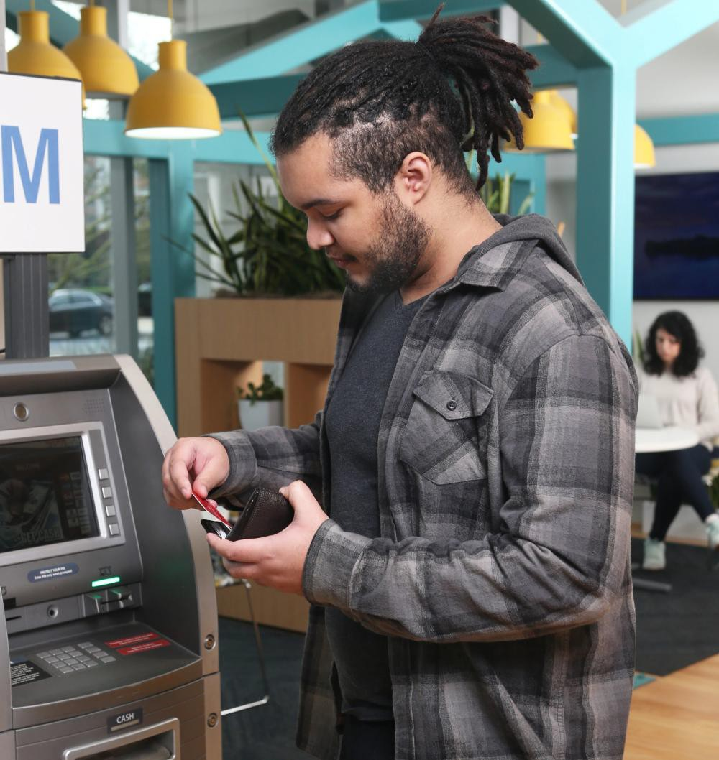
ITM fraud – unauthorized withdrawals from member accounts
What’s happening?
Fraudsters target the self-service feature at outside ITMs during
non-business hours (late night over weekends)
Access member accounts using counterfeit debit cards at ITMs
Many found deep insert skimmers on their machines
Others had fraudsters access member accounts using an alternate authentication allowed by the ITM – such as a combination of account number plus a SSN or date of birth
In some cases, fraudsters took advances against member home-equity line-of-credit (HELOC) loans at the ITMs
Mid six- and seven-figure losses are common

Slide 17
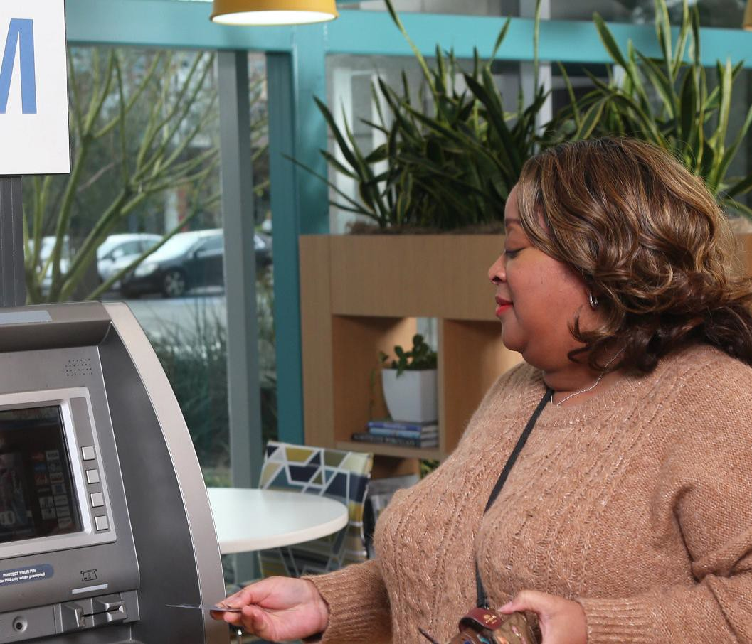
ITM fraud case studies
Credit union A Credit union B
Date of loss: March 24, 2023
Members affected: 197
Total loss: $1,747,785
Loss per member: $8,872
Withdrawals occurred over a 4-hour period using the self-service feature
Multiple individual member losses over $50,000
Date of loss: March 4, 2024
Members affected: 302
Total loss: $393,990
Loss per member: $1,305
Withdrawals occurred over a 6-hour period using the self-service feature
The disparity in losses:
Both credit unions had a single withdrawal limit of $2,500 but Credit Union A did not have a daily limit – fraudsters made
multiple $2,500 withdrawals from a single member’s account
Credit Union A allowed members to take advances against line-of-credit loans (e.g., HELOCs) using the self-service feature while Credit Union B did not
Credit Union A: Fraudsters took advances against member HELOCs to fund the withdrawals

Slide 18
ITM fraud risk mitigation
In general
Block all fallback transactions at ITMs and ATMs
Set reasonable daily withdrawal limits
Use skimming/shimming detection technology
Conduct daily inspections of all ITMs/ATMs –
including opening to inspect for deep shimmers
If foreign device or tampering is detected –
machine should automatically shut down
Ensure all ITMs and ATMs are EMV-enabled
Educate members of risk at ITM/ATMs –
report any signs of tampering
ITM self-service option:
If a debit card is used to authenticate members, ensure ITM reads the EMV chip, if it is not detected decline the transaction
Do not allow fallback transactions
Avoid using easily compromised identification to
access accounts (i.e.: SSN, DOB, account number)
Implement one-time passcodes sent to member devices before proceeding with transaction access
Set reasonable daily withdrawal limits
Single transaction and daily limits
Do not allow access to line of credit accounts
Limit hours of operations to normal business hours for self-service option and require members to use video teller if available. Machines can function as ATM during nonbusiness hours

Slide 19
ITM/ATM jackpotting
Proprietary and confidential. Do not distribute.

Slide 20
ITM/ATM jackpotting – causes machine to dispense cash
Mitigation tips
Work with ATM/ITM vendor
Replace the ATM/ITM top hat lock and equipping it with an alarm is critical - use an audible alarm to startle the criminal and get them to flee
Encrypt the machine’s hard drive
Encrypt the communication between the machine and the acquirer’s host system. If a router is used, the communication link between the machine and the router must also be protected.
Ensure the ATM/ITM operating system is supported and ensure security patches are installed when
they’re made available
Dispense throttling – shuts down machine when
velocity of cash dispensed reaches a specified limit
Frequent inspections
What’s happening?
Most common: fraudster infects the machine with malware. Usually by inserting a flash drive containing malware into the USB port – simply by accessing the ATM/ITM top hat
Fraudsters connect a black box, usually a laptop, directly to the ATM dispenser to send commands to the machine to disburse cash until its empty
Man-in-the-middle attack. Fraudsters install a device between the ATM’s computer and the network cable connection to the acquirer’s host system. Requires the fraudsters to insert any card - like a gift card or a stolen card – and messages are intercepted and modified
Proprietary and confidential. Do not distribute.
20

Slide 21
Fraudulent checks/deposits
Proprietary and confidential. Do not distribute.

Slide 22

Fraudulent checks/deposits
Significant increase in both frequency and severity of losses
Deploying tactics from well- known scams
Money mules continue to assist
Stolen mail is a key driver
Steal members’ issued checks and alters them or manufactures fraudulent checks using info from legitimate checks
Recruit money mules to open accounts at credit unions to cash stolen checks, including Treasury checks
Open fraudulent business accounts in the name of the payees listed on stolen checks

Slide 23
Fraudulent checks clearing member accounts
What’s happening?
Fraudsters steal members’ issued checks from blue
drop boxes
Alter checks (payee) and dollar amount
Manufacture fraudulent checks using the information
from members’ legitimate checks
Credit unions can recover losses from members’ altered checks (as well as checks containing a forged endorsement)
Pursue a breach of presentment warranty claim under UCC 4-208 against depositary institutions that accept members' altered checks
Credit unions typically take the loss from fraudulent checks created using information from members’ legitimate checks
Checks must be returned by the credit union’s
midnight deadline
Ensure members report unauthorized checks within the specified time frame in account agreement

Slide 24

UCC 4-208
presentment warranties
When a depositary institution accepts a check for deposit or payment
it makes certain warranties to the drawee institution under UCC 4-208:
The depositary institution is entitled to enforce the check (i.e., check does not contain a forged endorsement)
The check has not been altered
The depositary institution has no knowledge that the drawer’s
(accountholder) signature is unauthorized
For remotely created checks, the person on whose account the item is drawn authorized the issuance of the item in the amount for which it is drawn
Note: Credit unions must pursue the breach of presentment warranty claim within 30 days of learning of the breach. Missing the deadline does not absolve the depositary institution of its liability; however, the credit union may not be able to recover the full amount.

Slide 25
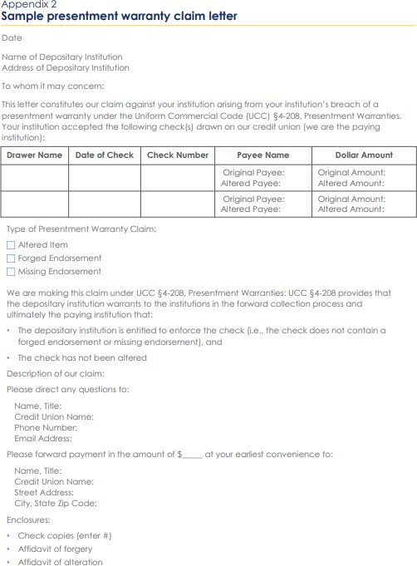
Breach of Presentment Warranty Claim under UCC 4-208
For checks drawn on the credit union
Send written demand to depositary institution
Depositary institution breached a presentment warranty under UCC 4-208 by accepting an altered check or one containing a forged endorsement
Include a copy of the item (front and back)
Include affidavit of alteration (if altered check) or affidavit of forged endorsement
Use the correct affidavit
The date of affidavit may be viewed as the date of discovery so send the demand letter within 30 days of the date of the affidavit
Pursuing a breach of warranty claim under UCC 4-208 >>> Risk overview & sample letter

Slide 26

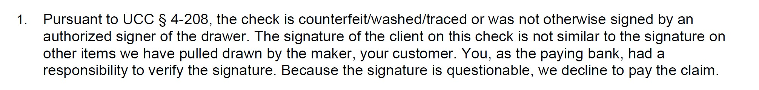
Some FIs are denying credit union
breach of presentment warranty claims
They’re wrong
Be persistent – make 2nd & 3rd requests
Threaten legal action, if necessary
These financial institutions will eventually
return the funds to the credit union

Slide 27
When fraudulent checks clear a member’s account
Open new account with new account number and freeze old account
Request list of outstanding checks from member
Manually clear the checks against the old
account as they’re presented for payment
Determine if the member reported the unauthorized checks within the timeframe outlined in the account agreement
Don’t recredit member if reported late
If applicable, pursue a breach of presentment warranty claim against the depositary institution
Perform manual review of large dollar checks (e.g., $10,000 or more) presented for payment
Verify member signatures against reliable specimens (e.g., signature card or loan documents)
Call member to verify that they actually issued the check to the stated payee for the amount listed
Check the member’s account to make sure the phone number was not changed in the last 60 days before making the call
Review must be performed timely to allow the credit union to return unauthorized checks by their midnight deadline
Consider offering payee positive pay to business members

Slide 28
Fraudulent business accounts
Proprietary and confidential. Do not distribute.

Slide 29
Fraudulent business accounts
What’s happening?
Fraudsters - or their money mules - open fraudulent business accounts to cash stolen checks, including Treasury checks, that are made payable to a business
Account opened in the name of the business listed as payee on the stolen check
Fraudsters file fraudulent articles of incorporation with the secretary of state and provide this document to the credit union at account opening
Credit unions receive a breach of presentment warranty claim from drawee institutions claiming credit unions accepted check containing a forged endorsement
For Treasury checks, credit unions receive a notice of reclamation – forged endorsement
Red flags
Articles of incorporation dated just days before the
fraudulent business account is opened
Stolen checks are dated 3 to 8weeks before the date of filing stamp on the articles of incorporation
Payee’s address on the check bears no relationship with the address used to open the fraudulent business account
Business name listed as payee on the check may not exactly match the name of the fraudulent business account

Slide 30

Fraudulent business account
case study - $549,000 loss impact
Money mule opened a fraudulent business account at a credit union on 7/12/2023 to cash a $549K stolen check
Account opened in the name of the payee on the check
Provided fraudulent registered articles of incorporation -
filed 6/26/2023
Funds withdrawn through various means after the check hold expired
Credit union received a breach of presentment warranty claim from the bank on which the check was drawn
Red flags
Articles of Incorporation filed 6/26/2023
The check was dated 6/12/2023
Payee’s address listed on the check was Chicago –
account opened using a Michigan address

Slide 31

Risk mitigation – fraudulent business account
Deploy identity verification solution to verify the identity of new members
Verify business entities by obtaining registered articles of incorporation
Be wary of recently filed articles of incorporation
Do a search on the business name
Place extended holds on checks deposited to new accounts in
accordance with Reg CC
Exercise caution when new members present large dollar checks, including U.S. Treasury checks, for deposit or payment
Consider accepting the checks for deposit to member savings accounts so that a longer hold (e.g., 11 days) can be imposed (subject to state laws in CA, CT, MA and NY)
Consider establishing a waiting period before new members can use remote deposit capture service

Slide 32

Stay on top of the changing fraud environment
Craft risk mitigation strategies accordingly
Rinse & repeat – it’s a continuous process
Wrap-up

Slide 33
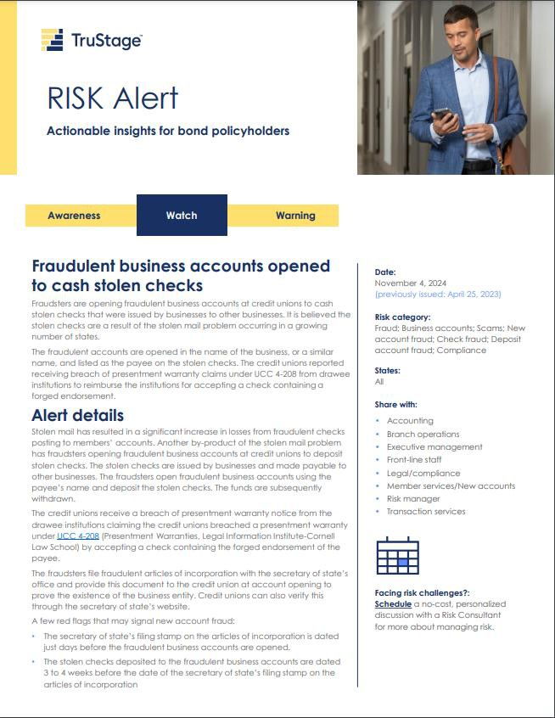
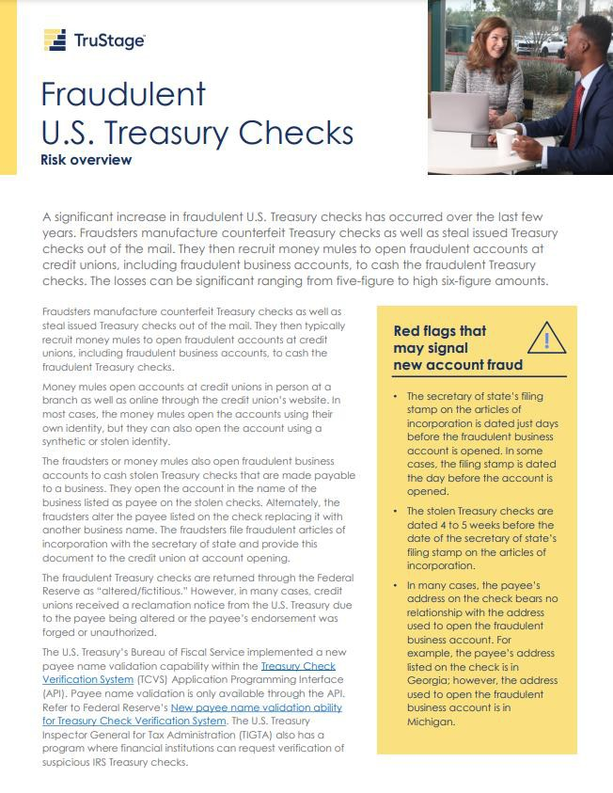
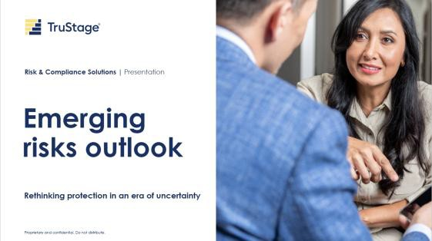
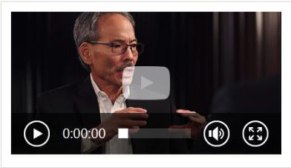

Risk resources
Business Protection Resource Center www.trustage.com/bprc
RISK Alerts – warning | watch | awareness Loss prevention library - risk overviews, checklists & whitepapers Emerging risks outlook Live webinars, risk forums & office hours On-demand learning & interactive training modules
“Great information, excellent format. Presenters were engaging and knowledgeable in their respective fields.”
Executive Vice President - $3B credit union

Slide 34
Thank you.
Contact Riskconsultant@trustage.com 800.637.2676
This presentation was created by the CUNA Mutual Group based on our experience in the credit union and insurance market. It is intended to be used only as a guide, not as legal advice. Any examples provided have been simplified to give you an overview of the importance of selecting appropriate coverage limits, insuring-to-value and implementing loss prevention techniques. No coverage is provided by this presentation/ publication, nor does it replace any provisions of any insurance policy or bond.
TruStageTM is the marketing name for TruStage Financial Group, Inc., its subsidiaries and affiliates. TruStage Insurance Products offered to financial institutions and their affiliates are underwritten by CUMIS Insurance Society, Inc. or CUMIS Specialty Insurance Company. Cyber policies are underwritten by Beazley Insurance Group or other nonaffiliated admitted carriers.
This summary is not a contract and no coverage is provided by this publication, nor does it replace any provisions of any insurance policy. Please read the actual policy for specific coverage, terms, conditions, and exclusions.
© TruStage

